Slide 1
Why Didn’t They Teach Me This in College?!
An Educator’s Guide to School Facilities
Ken Wertz, Executive Director
Massachusetts Facilities Administrators Association (MFAA)

Slide 2
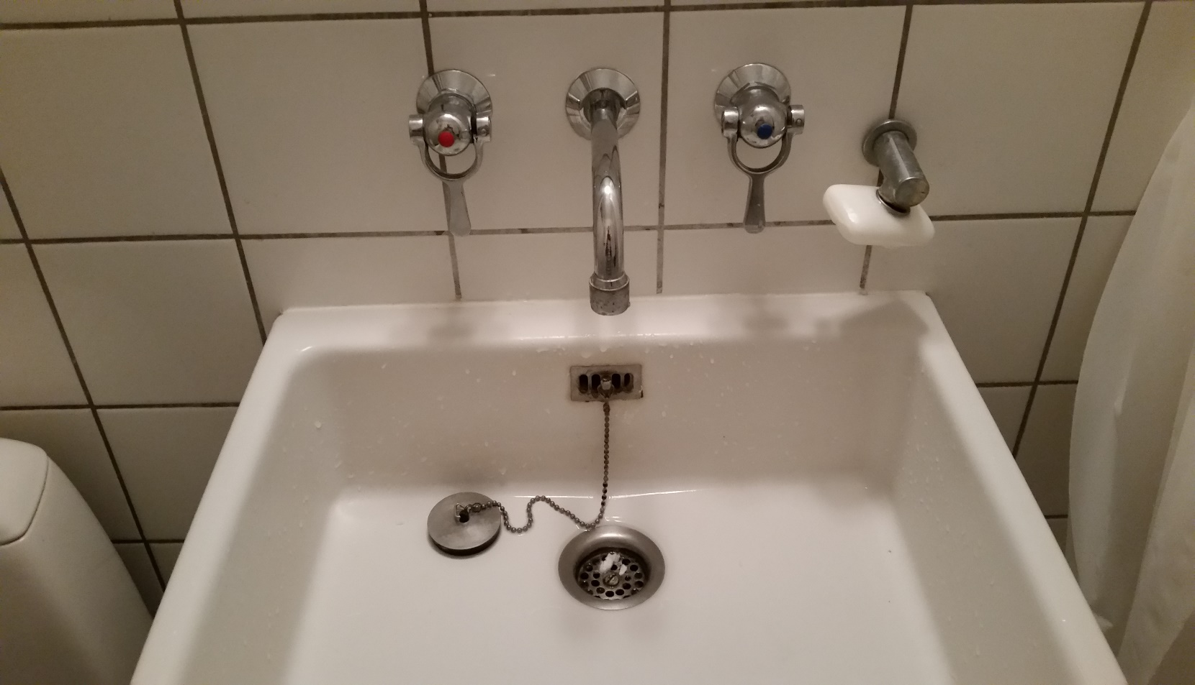
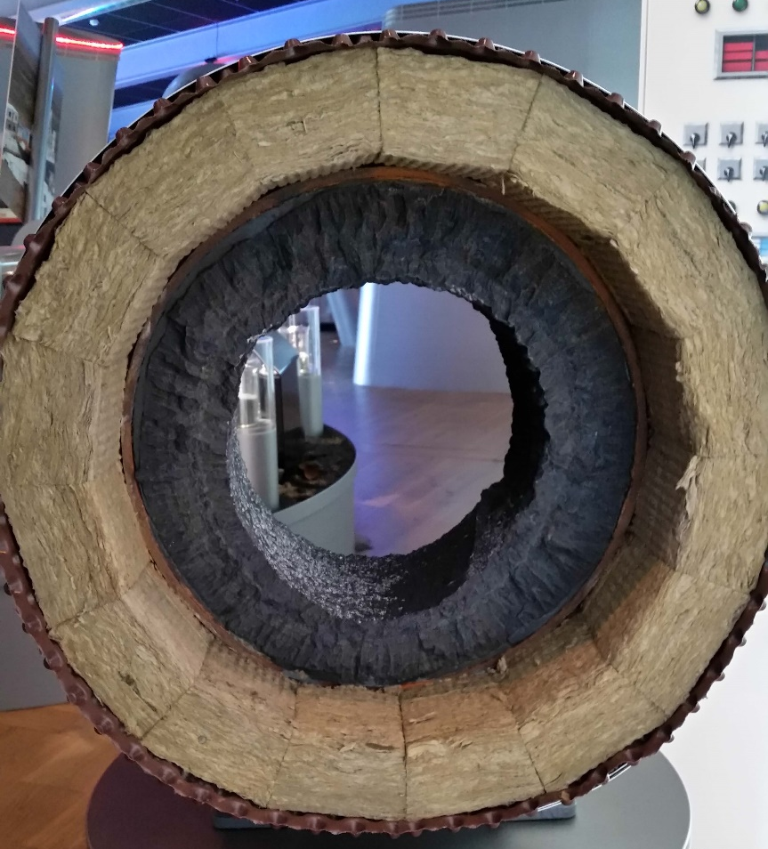

Our Brains are wired different…

Slide 3
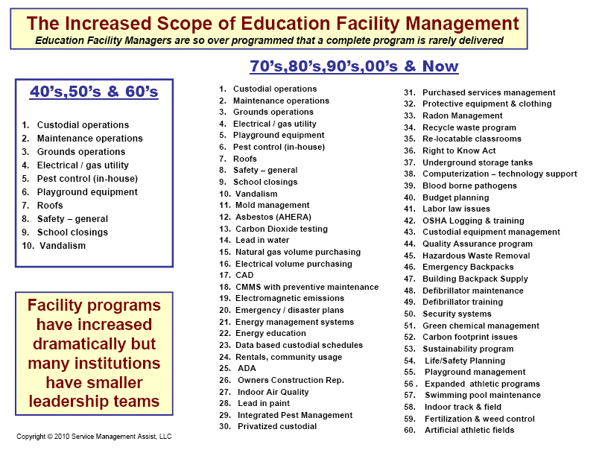

Slide 6
Codes…..
IBC- International Building Code w/ 780 CMR-MA Amendments
IEBC- International Existing Building Code
IECC- International Energy Conservation Code (Stretch Code Bldgs.)
IMC-International Mechanical Code
MGL 248 CMR – Plumbing Code
IFC- International Fire Code
MGL Ch.149 Section 6 MA DLS – OSHA compliance
521 CMR- MA Accessibility Regulations
310 CMR 7.15 Asbestos (MA Dept. Labor Standards)
H.R.4939 – Lead Contamination Control Act LCCA (1998)
454 CMR Section 21 – Right to Know training
And on and on and on……………..

Slide 7
Relationships/Partners
Local officials: Inspectors, Fire, Police, Health Dept.
State: DLS, DPS, DOS, DEP, EPA
Insurance Carrier (MIIA)

Slide 8
M&O Budget
Operations
Capital
Employees
Equipment Life Cycle
Staffing
Contracted
Utilities
Special Projects
Energy Project
Reactive
Major Replacement
General
Mandated
Planned-Preventative

Slide 9
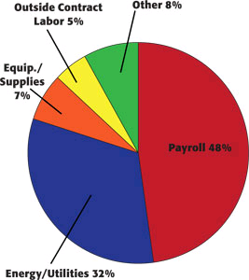
Notes:
Do you know your second largest line item in you budgets after salary? Utilities… and do you just pay the bill when it comes in or do you have someone dedicated to reducing consumption “Energy Manager” or even better a “building operator” not just another added task to your facilities director that is already pulled in too many directions.

Slide 10
M&O Budget
Operations
Capital
Employees
Equipment Life Cycle
Staffing
Contracted
Utilities
Special Projects
Energy Project
Reactive
Major Replacement
General
Mandated
Planned-Preventative

Slide 11

Notes:
Maintenance Departments are often times the Island of misfit toys. My electrician is a Charlie in the box, plumber a squirt gun that shoots grape jelly…..

Slide 12
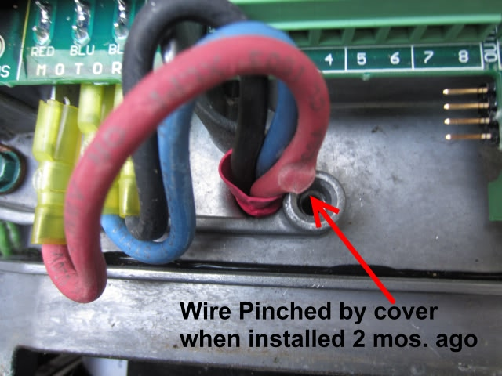
Notes:
They spend their days looking for a crimped wire in a sea of building components

Slide 13
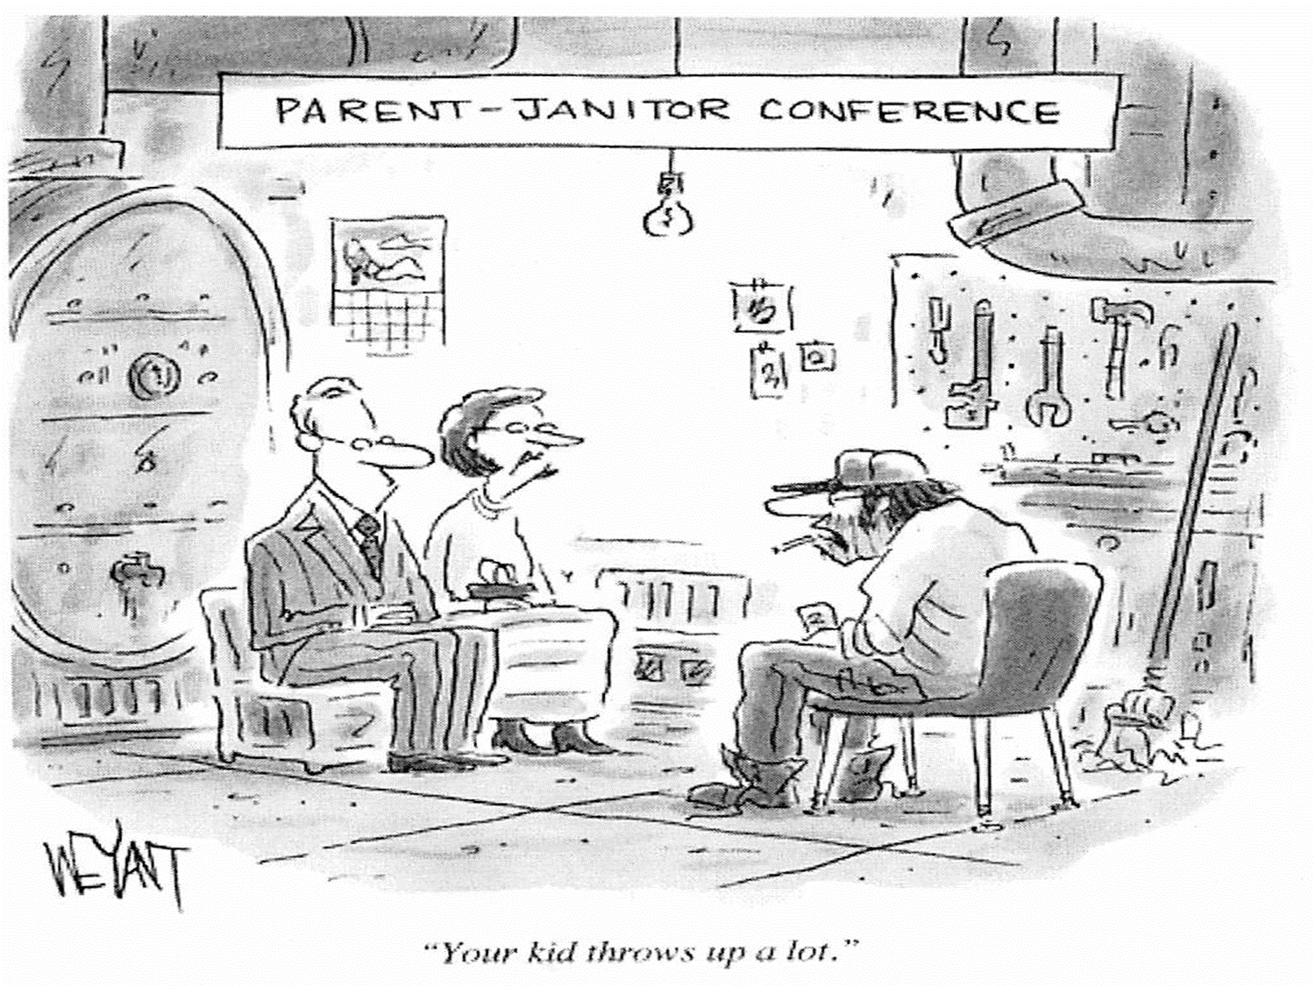

Slide 14

PERFORMANCE
Public Perception (right or wrong)
Pride in Ownership
Lack of Expertise
Lack of Training
Lack of Supervision
Good enough……

Slide 15
Notes:
We are currently funded for level 4 in our schools… wouldn’t it be nice to move up to level “Causal Inattention”

Slide 16
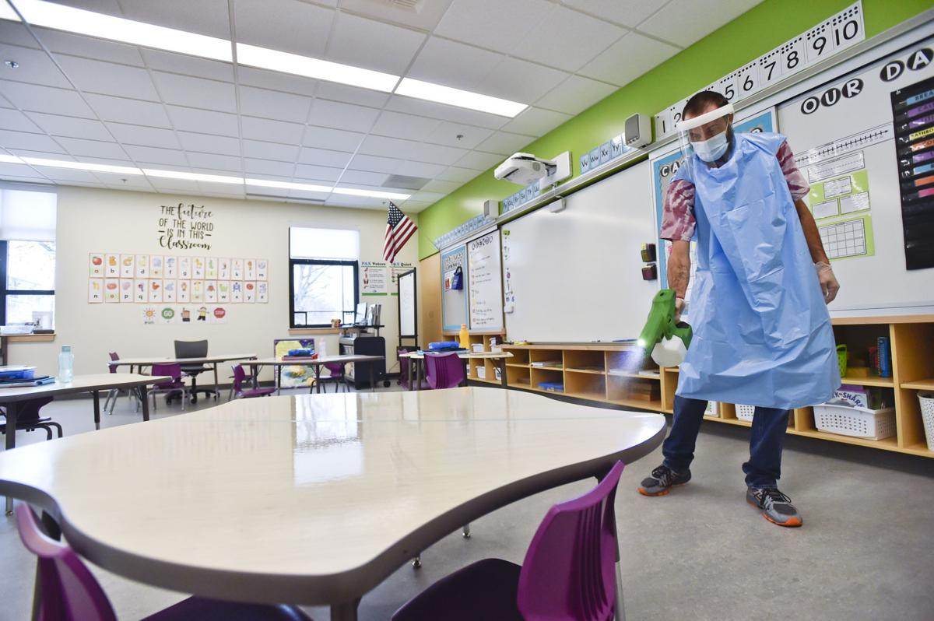

Slide 17
Cleaning vs. disinfecting vs. sanitizing
  Process
  Dwell time
  Bleach concerns
  DfE preferred – EPA registered on list N (rinse Free and PPE)
    Likarr - BETCO GE Fightback
    Hillyard - Cleancide
    Casey – Ecos Pro
Electrostatic Sprayers – Foggers - Other
  Foggers use - ULV (ultra low volume) droplets
  Electrostatic charge particles that wrap and cling
  Weed Sprayers – paint sprayers … Good Lord Just NO!

Slide 18
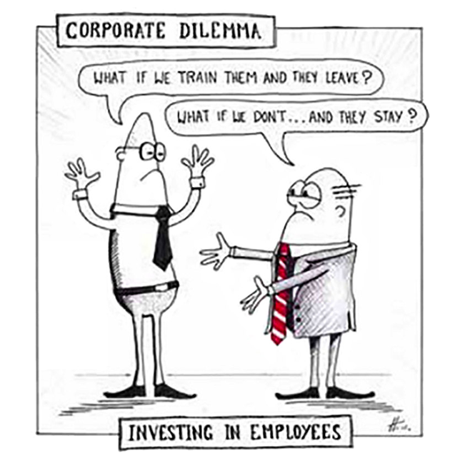
Notes:
You have to provide PD to ALL your staff much like you do for your teaching staff. A box of Joe and a dozen donuts with a supplier for 30 minutes is nice but isn’t really PD.

Slide 19
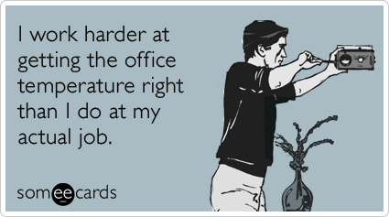

Slide 20
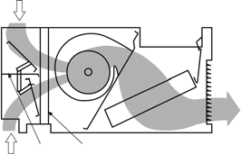
FILTER
Heating Coil

Slide 21
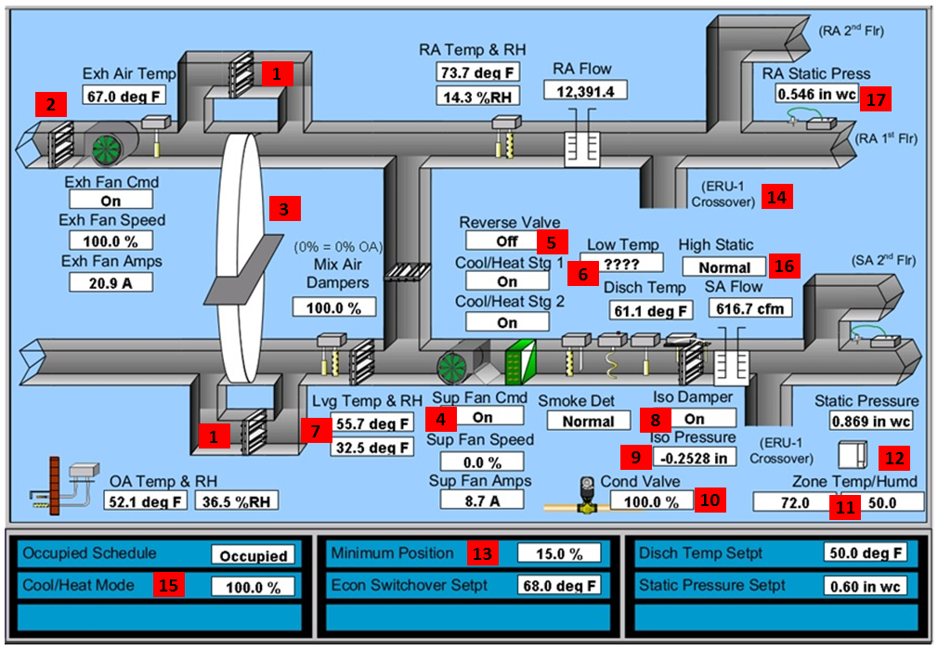
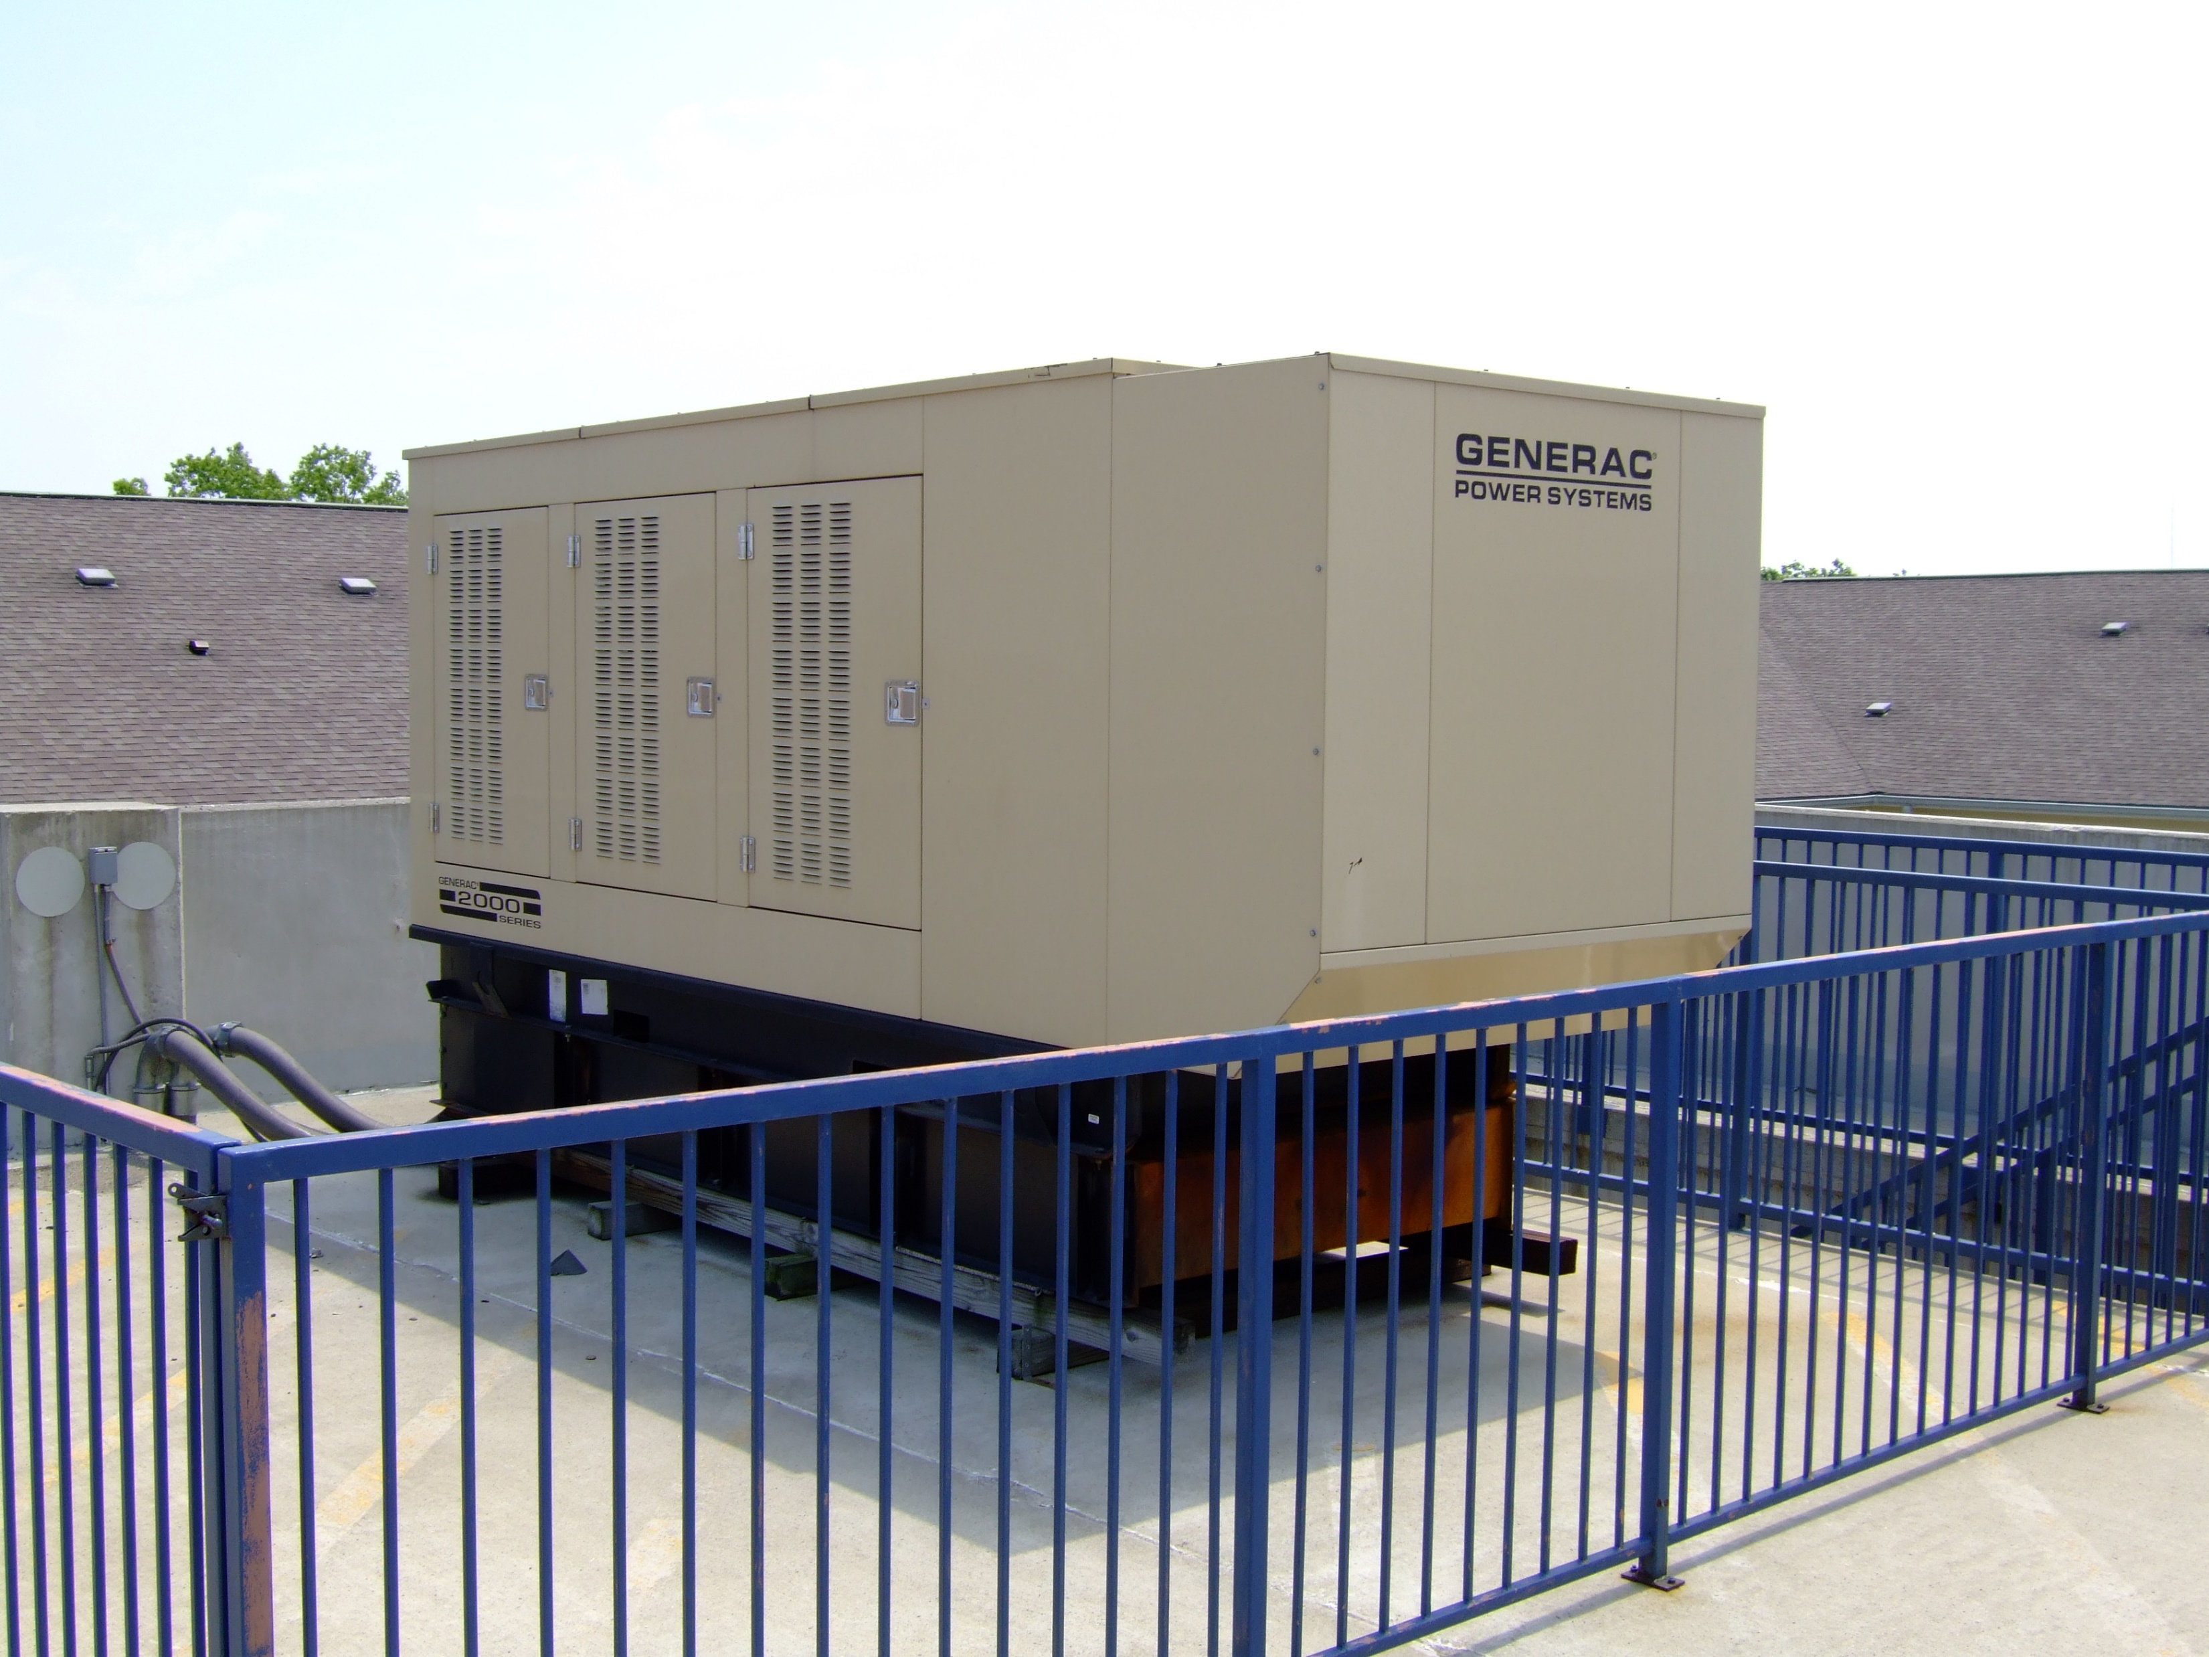
Building Automation Isn’t Automatic…

Slide 22

https://thecogfxstudy.com/

Slide 23
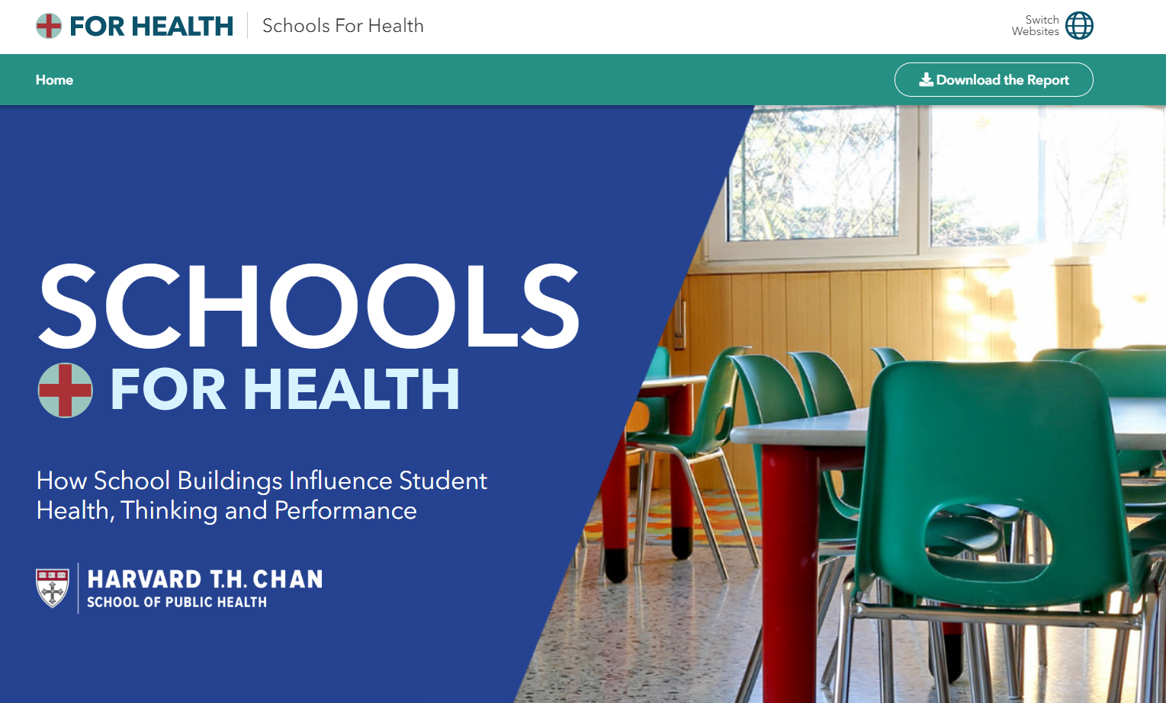
https://schools.forhealth.org/

Slide 25
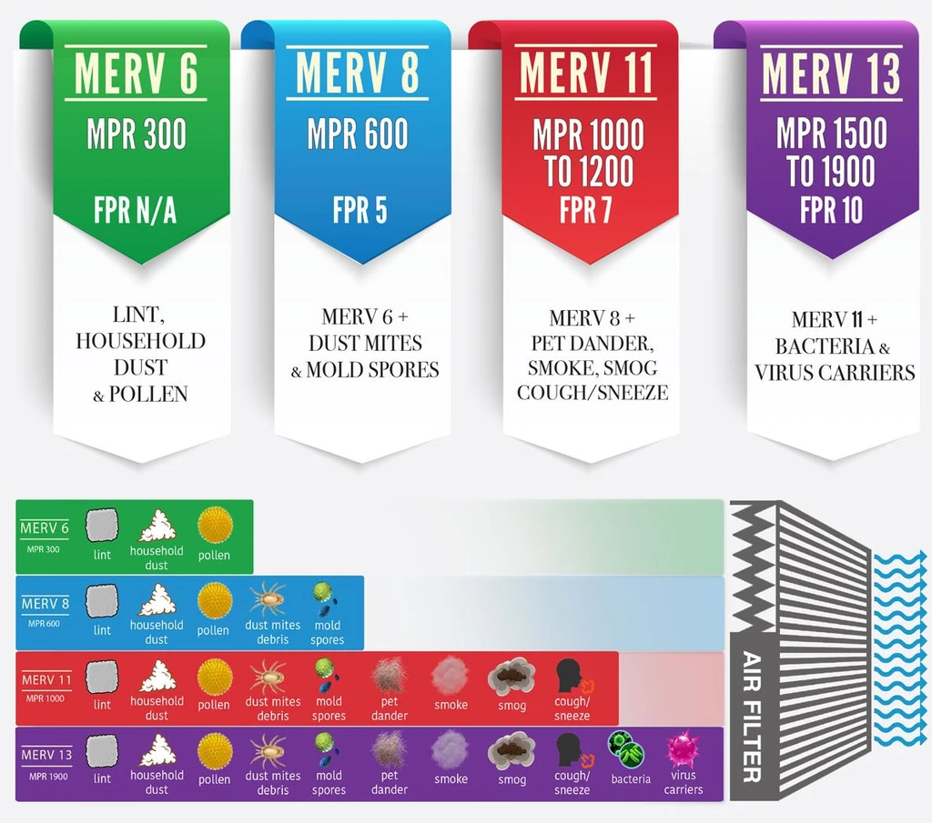
What have we learned?

Slide 26
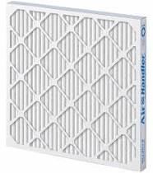
Increased Filtration
MERV 8
VS.
MERV 13
Unit cost 2.5 to 3 times more
Increased utility costs

Slide 27
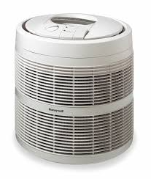
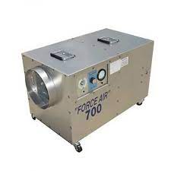
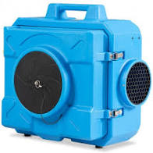
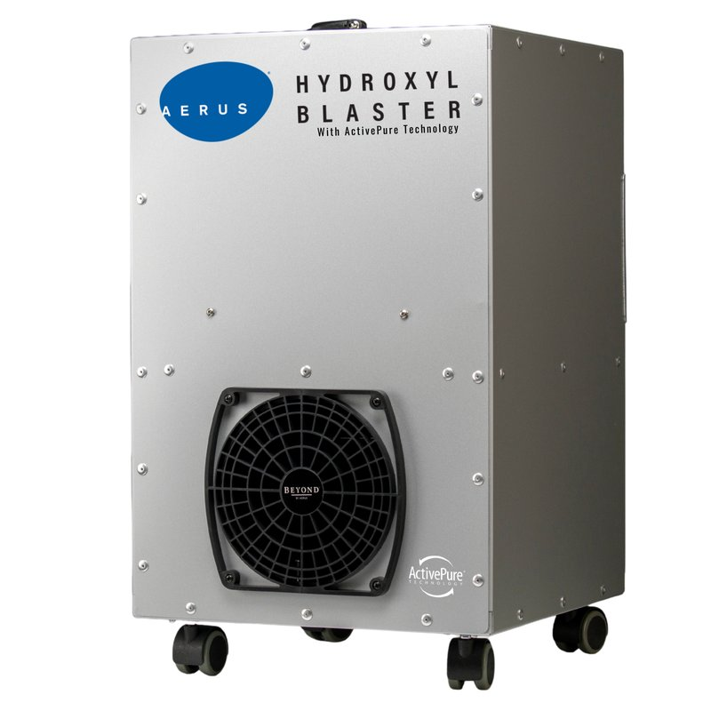
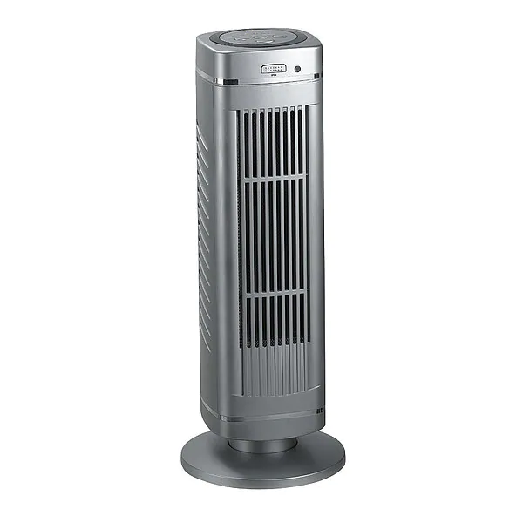
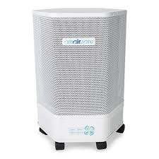
Decisions…Decisions…
Notes:
Buyer beware! Both adequate sizing along with making sure the unit doesn’t emit Ozone!

Slide 28
M&O Budget
Operations
Capital
Employees
Equipment Life Cycle
Staffing
Contracted
Utilities
Special Projects
Energy Project
Reactive
Major Replacement
General
Mandated
Planned-Preventative

Slide 29

Special Projects
Was funding in operations budget?
“Our M&O team can do it…”
  What is deferred by self performing?

Slide 30
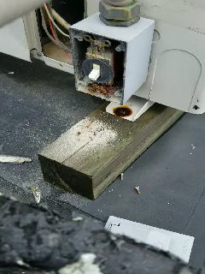
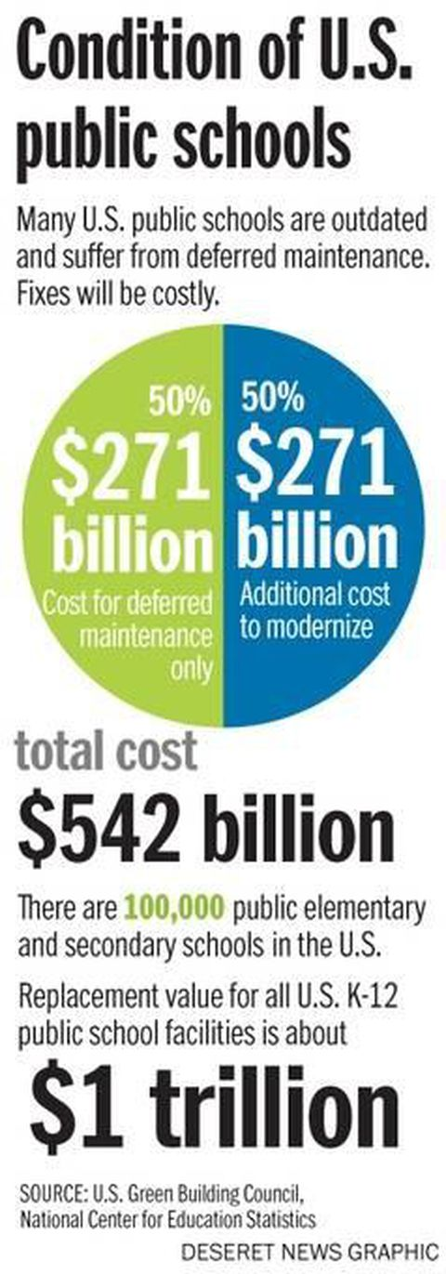
Deferred Maintenance
2013

Slide 31
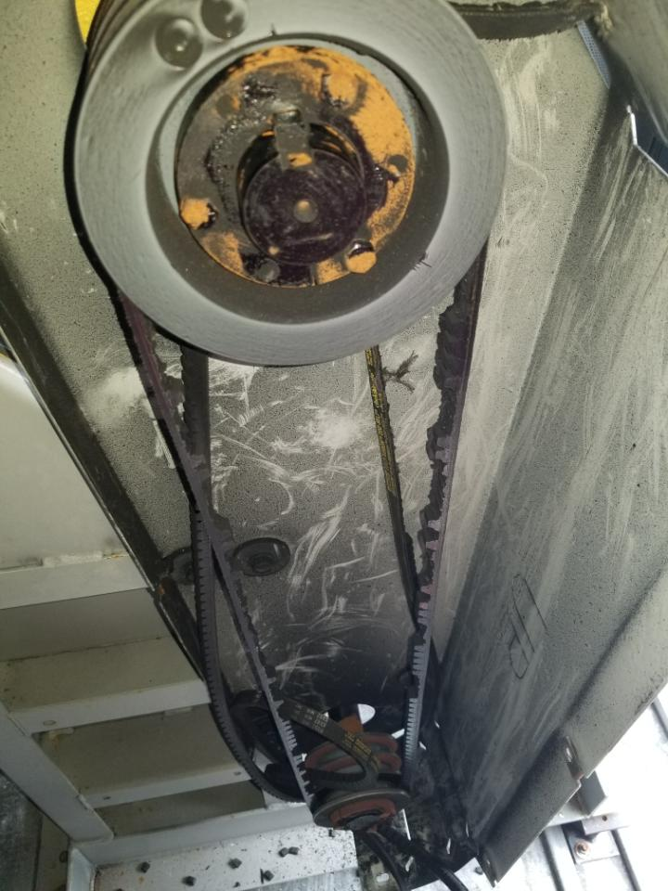
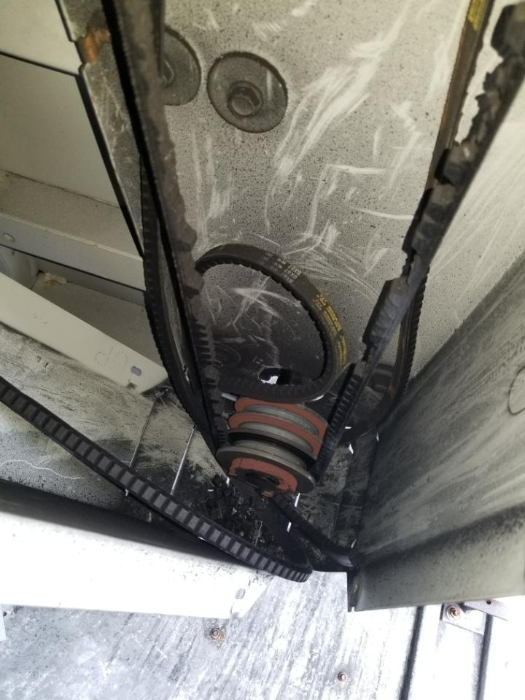

Slide 32

HVAC a ’la
Laura Numeroff
Notes:
Uni-vent replacement means asbestos abatement which could include ceiling?floors?; Air conditioning add means more power so change out your electrical system, now adding things up you trigger ADA upgrade and now you have an MSBA core project! You can’t just pick HVAC without the mouse wanting a drink of mile too….

Slide 33
Capital Planning
Data driven decision making
Project budgets
  Internal estimates
  Consultants
  RS Means
Prioritized 5-Year Plan
  Built in escalation
  Include all Departments in forecast

Slide 34
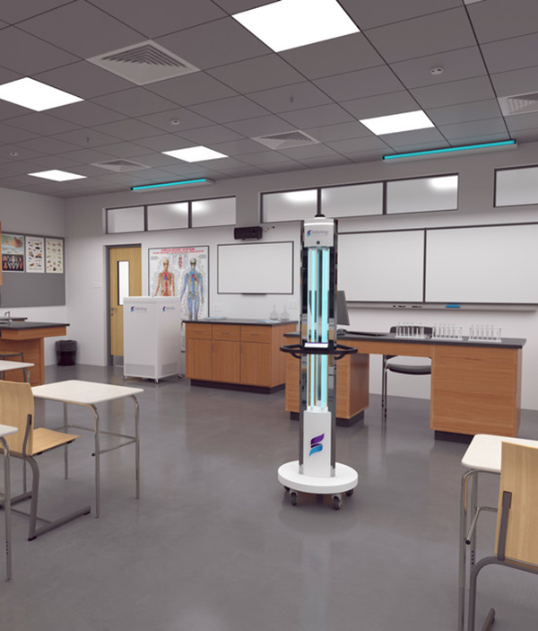
Classroom UVC Lighting
Up-lighting (permanent)
Portable Tower

Slide 35

Benchmark ???
School Maintenance costs per sq. foot:
$2.50 to $9.50

Slide 36
How Soon We Forget…
Notes:
People have already moved on from COVID and hearing rumblings about maintenance budget cuts. That is what us got here in the first place. Talk to your facilities directors, understand realistic cost per sq. foot to fund routine and predictive maintenance and not just reactive.

Slide 37
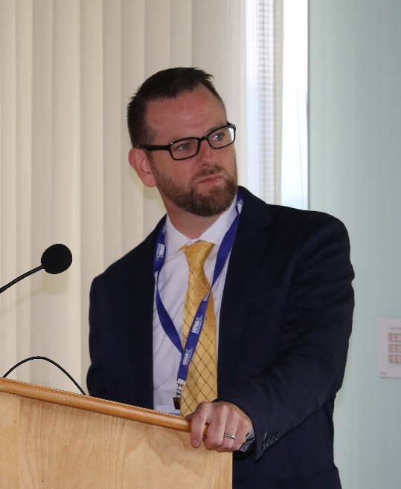

https://massfacilities.com/covid-resources/
Ken Wertz
MFAA Executive Director
exec@massfacilities.com

