Slide 1

Employee Accidents and Injuries –
What Every Facility Manager Should Know
Presented to:
Massachusetts Facilities Administrators Association
November 17, 2016
Mary Dozois, CIH
Department of Labor Standards
www.mass.gov/dols/wshp
508-616-0461

Slide 2

Objectives
What types of injuries happen to employees?
What happens during a DLS safety inspection?
Examples of violations found at recent DLS inspections.

Slide 3
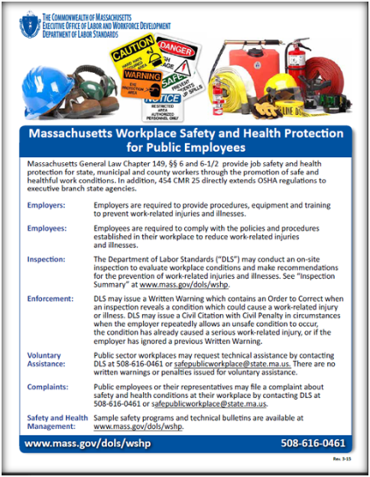
Workplace Safety for Public Sector
Is public sector required to follow OSHA?
YES!
MGL c149 §§ 6 and 6-1/2
require public sector employers to prevent work-related injuries.
Complying with OSHA standards is the minimum strategy to prevent injuries.

Slide 4
Public Sector Laws
Remain Under
MGL c149 §6
City/Town/County
New Law –
MGL c149 §6-1/2
Executive Branch
Authorities
Old: Before 1970
New: March 25, 2015
Has ability to FINE!
Ability to FINE, same as MGL c149§6.

Slide 5
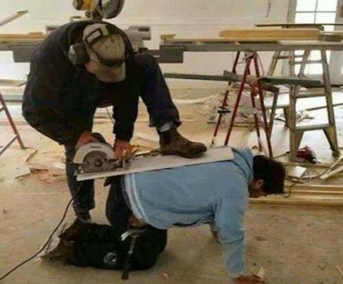
Why Do We Need Regulations?

Slide 6
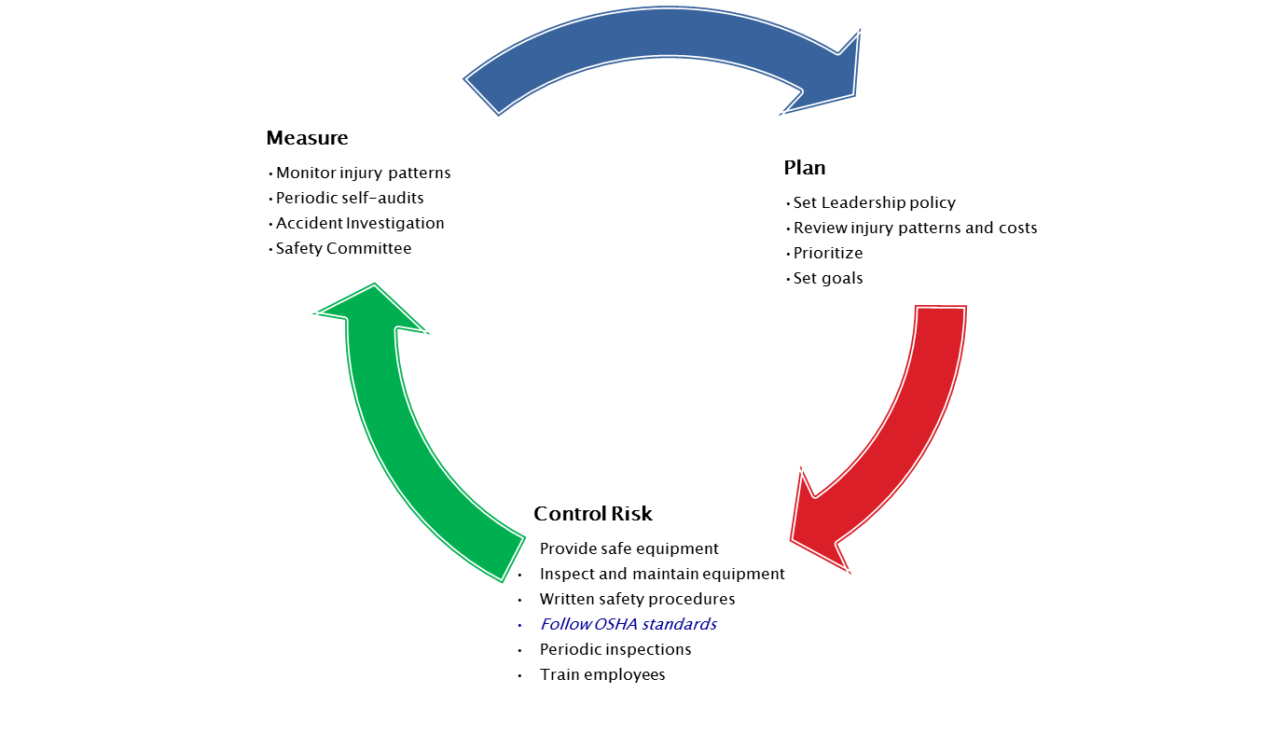
Safety Management

Slide 7
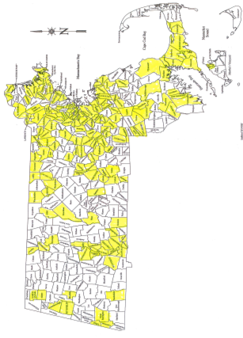
Who Has Been Inspected?
From 2013-2016,
DLS has conducted safety inspections in
155 cities and towns.
In some towns, more
than one department
has been inspected
(ie. school; DPW; water; electric).

Slide 8
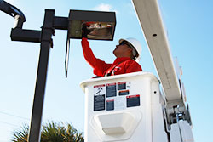
Who Gets Inspected by DLS?
1. Imminent Danger
  Bucket Truck
  Trench
  Roof
2. Significant Injury
Fatality; Hospital; Burn; Amputation; Electric Shock
3. Complaints and Referrals
4. Programmed Schedule
Water/sewer; school kitchen;
airport; landfill
5. Voluntary Request by Employer
Notes:
The DLS priority is similar to the priority listed in the OSHA Field Operations Manual.
First priority is Imminent Danger. Imminent means that there is a condition which could cause death or serious physical harm immediately.
Examples include trench cave-in, falling out of an aerial lift bucket truck, getting hit by vehicle traffic, falling off a roof.
Second priority is a work-related injury that caused a fatality or hospitalization. DLS will investigate all work-related events which required EMS response or medical treatment at a hospital. Examples include amputation; electric shock; burn.
Third priority is Complaints and Referrals.
Complaints can be filed by employees or union representatives.
A Referral can be made by other state agencies (Public Health; Public Safety) or OSHA.
Note that all complaints are not created equal. DLS will prioritize complaints according to risk of injury. Therefore a complaint about unsafe machinery will be higher priority than a complaint about lighting.
4. Programmed Schedule. Each year DLS will develop a list of prospective inspection sites, based on risk of injury at those sites. For example, the goal would be to inspect a certain number of healthcare sites per year, transportation sites per year, facilities maintenance per year, etc.

Slide 9
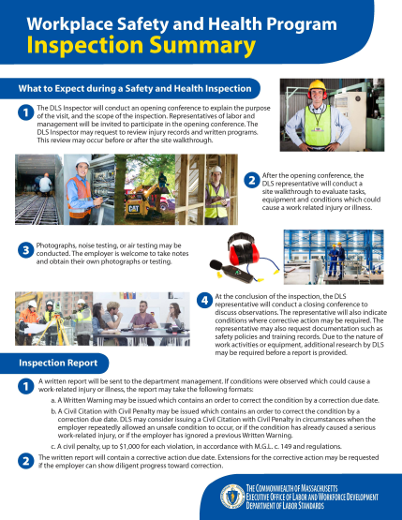
What Happens During Inspection?
Opening Conference
Walk-through
Closing Conference
DLS will also ask to speak with the local union steward.

Slide 10
Will There be a Penalty?
Goal: Preventing Injury and Illness
First Enforcement: No Fine
  Written Warning with Order to Correct
  Response required before Due Date
Second Enforcement for Same Violation:
  Civil Citation with Civil Penalty
  $1,000 per violation
  To date, no penalties issued
Notes:
NOTES:
DLS policy matches the same approach taken in New Jersey, and Connecticut. State agencies are given a chance to correct the violation before a due date. If the problem is fixed, there is no fine or penalty. If the agency can make progress on correction, but needs more time, an Extension can be requested. This is because the primary goal is to prevent work-related injuries, not collect fines.
The Written Warning issued by DLS will include a description of the hazardous condition, reference the OSHA standard that requires correction, and give a suggested strategy for the agency to correct the condition. An agency may develop their own strategy – this is fine as long as the condition is fixed.

Slide 11
Municipal Injury Pattern

Slide 12
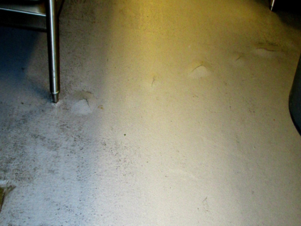
Slip, Trip
In 2015, DLS issued a Written Warning for a slip hazard in school kitchen.
Building is 2-yr old!
School fixed the floor. No fine or penalty.
OSHA: 29 CFR 1910.22
Massachusetts Law M.G.L. c149 s
Notes:
Middle school, kitchen floor

Slide 13
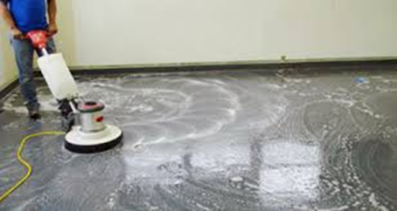
Floor Finishing
DLS inspections:
Overboots
PPE assessment
Safety Data Sheet
Ventilation
During stripping season there are 3-5 injuries per week across the state: Slips; burns.
OSHA: 29 CFR 1910.132 (PPE)
29 CFR 1910.1200 (RTK)
State: MGL c.149 s.18E; MGLc111F

Slide 14
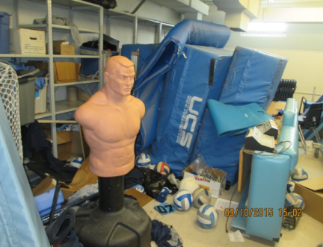
Slip, Trip
In 2015, DLS conducted an inspection at a school due to a broken leg.
School fixed the storage room.
No fine or penalty.
OSHA: 29 CFR 1910.22
Massachusetts Law M.G.L. c149 s18A
Notes:
Middle school – fractured ribs

Slide 15
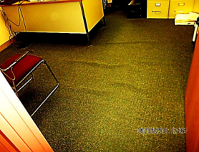
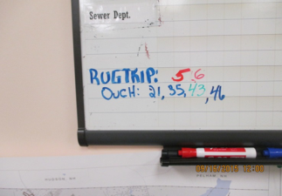
Slip, Trip
In 2015, DLS conducted an inspection at a
town office due to a complaint.
The employees kept a tally of how many people tripped.

Slide 16
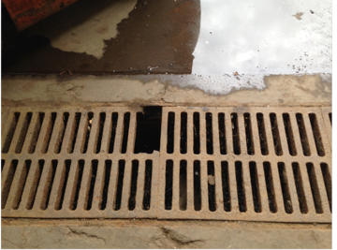
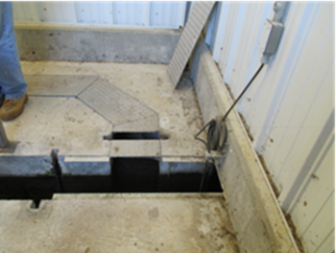
Floor Holes
DLS Inspections
Floor opening greater than 1inch.
Cover available, not replaced.
OSHA 1910.23 (a)
MGL c149 s.6, 18A

Slide 17
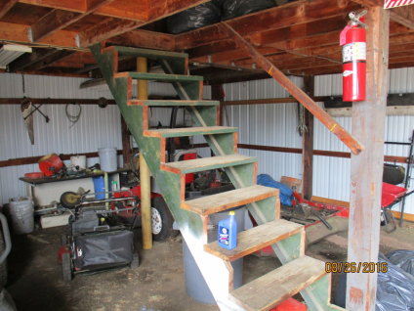
Stairs and Railings
DLS Inspections:
Lack of handrail
Lack of railing on the mezzanine level
OSHA: 29 CFR 1910.23(d)(1)(ii)
MGL c149 §6

Slide 18
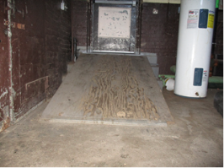
Ramps
Inspection History
Lack of railings
Slippery
Lighting
Uneven surface
Gap at door
School:
Worker fell off ramp when carrying coolers.
OSHA 5(a)(1)
MGL c149 §6

Slide 19
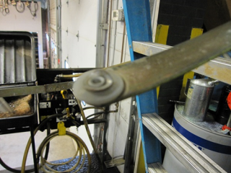
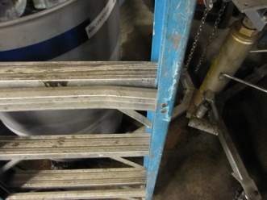
Ladder Accidents
DLS Inspections:
Lack of inspection
Lack of training.
State: MGL c.149 s18A
OSHA: 29 CFR 1910.22(d)(1)
Broken crossbar, missing rivets, warped steps, ladder rated only for 150 pounds

Slide 20
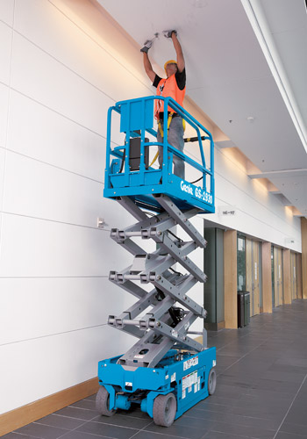

Scissor Lifts
DLS Inspections
Lack of Training
Lack of Preventive Maintenance
Pre-operation inspection check
Accidents Investigated:
Fall when climbing off platform
Carry off theater stage

Slide 21
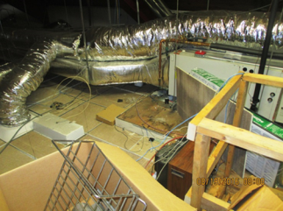
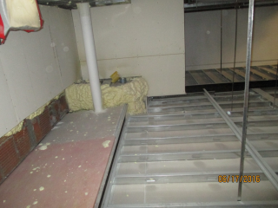
Attic Floors
DLS Inspections:
Lack of railing where floor ends
Worker fell thru when stepped off of plywood path onto the 2x4 ceiling tiles for the room below.
OSHA 29 CFR 1910.23(c)(3)
Plywood path for HVAC access adjacent to 2x4 ceiling tiles.

Slide 22
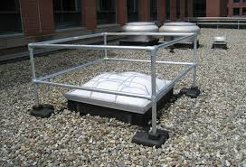
Skylights: Fall Protection
Skylights must be protected by railing, cage, screen or net.
In 2015, DLS issued a Written Warning after a town employee fell through a skylight.
OSHA: 29 CFR 1910.23(a)(4)
Massachusetts Law M.G.L. c149 s6

Slide 23
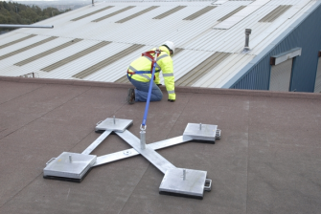
Roof: Fall Protection
Workers performing inspection or maintenance on roof must be protected from falling off roof.
Methods include:
  Guardrails (6ft from edge)
  Restraint system
OSHA: 29 CFR 1910.23
State: M.G.L. c149 s6

Slide 24
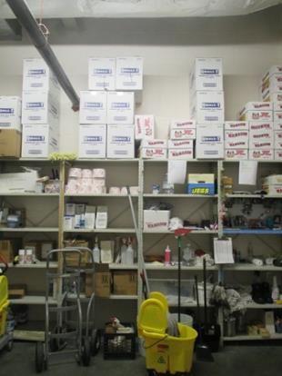
Lifting: Back Injury
In 2015, DLS issued a Written Warning for a Back Injury hazard in custodian closet.
40-pound boxes of copy paper were stored high above the floor. Workers used a ladder to retrieve heavy boxes.
OSHA: 29 CFR 1910.176(b) Massachusetts M.G.L. c149 s6

Slide 25
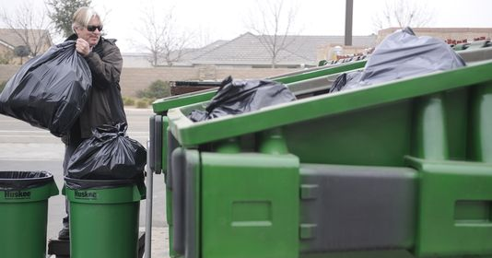
Lifting: Back Injury
Injury History:
5 back injuries per week – custodians lifting trash barrels.
Solutions:
Barrel design
Smaller bags
Dumpster: not lifting bags over shoulders.
Training on Safe Lifting
OSHA: General Duty Clause
State: MGL c149 s.6
No DLS citations yet for injuries caused by trash handling.

Slide 26
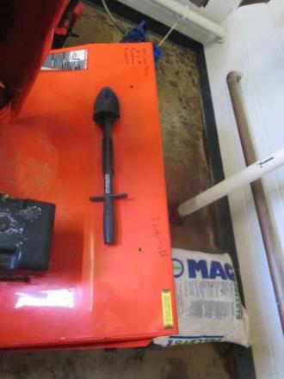
Amputation Investigation
In 2014 and 2015, DLS issued Written Warnings for amputations caused by snowblowers.
Cause:
Poor equipment maintenance;
Missing tool;
Lack of training per owners manual.
OSHA: 1910.212(a)(3)
State: MGL C149 s.18C

Slide 27
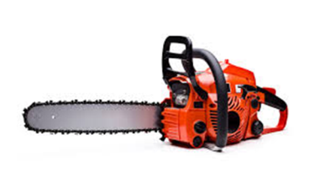
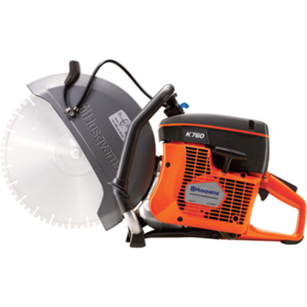
Power Tool Accident Investigations
Written Warnings issued for:
Lack of training according to Owner’s Manual.

Slide 28
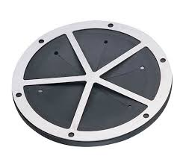
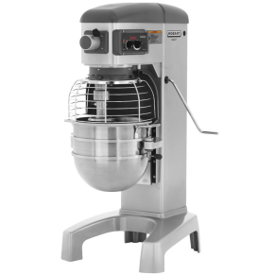
Kitchens
DLS Inspections
Machine guard on dough mixer
Throat guard on sink disposal
Corrosive cleaning products - eyewash
OSHA 29 CFR 1910.212(a) (3) (ii)

Slide 29
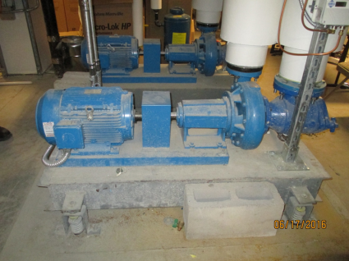
Mechanical
Unguarded shaft. Guard does not cover entire rotating area.
DLS Inspections
Machine Guarding
Lockout Tagout Program
Lockout Tagout training
Painting pump while still running, no Lo/To
OSHA 29 CFR 1910.219 ( c) 2

Slide 30
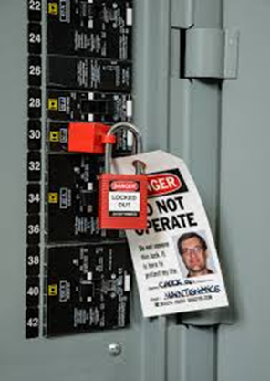
Lockout Tagout
Repair/maintenance on live equipment is forbidden.
Lo/To is required:
List of equipment
Steps for shut down
Locks and tags
Procedure for lock removal
Written Program
Training
OSHA: 29 CFR 1910.333
Massachusetts: M.G.L. c149 s18C

Slide 31
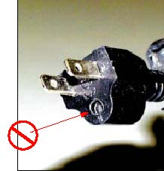
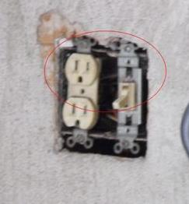
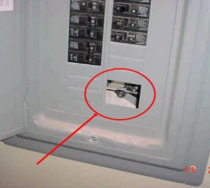
Electrical – Common Citations
OSHA 1910.334(a)
State: MGL c.149 s6
OSHA 1910.305(b)
State: MGL c.149 s6
OSHA 1910.305(b)(ii)
State: MGL c.149 s6

Slide 32
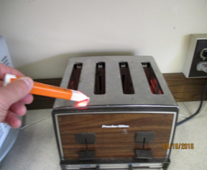
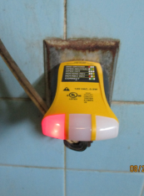
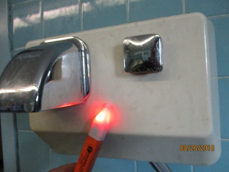
Electrical Wiring
Inspection History:
Receptacle with an open ground.
OSHA 29 CFR 1910.304(b)(2)(ii)
National Electrical Code
MGL c149 §6

Slide 33
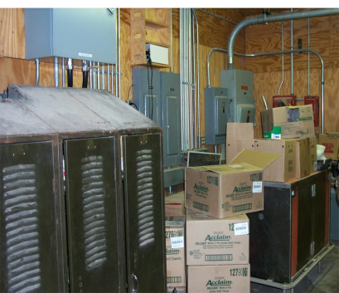
Electrical Panels
DLS Inspections Access blocked
Solution:
Keep 3ft clearance on front and side of electrical panels
OSHA 29 CFR 1910.303(g)(1)(ii) National Electrical Code
MGL c149 §6

Slide 34
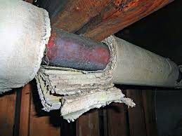
Asbestos in Schools
Keep Asbestos Materials in good condition.
Know what materials are in your building.
Inform custodians and contractors.
Label asbestos materials in custodial and mechanical areas.
Train custodians.
Re-inspection: every 3 years.
Inspections to prevent work-related injury are conducted by the Department of Labor Standards’ Workplace Safety & Health Program.
Inspections for Asbestos in Schools are conducted by the Department of Labor Standards’ Asbestos/Lead Program.

Slide 35
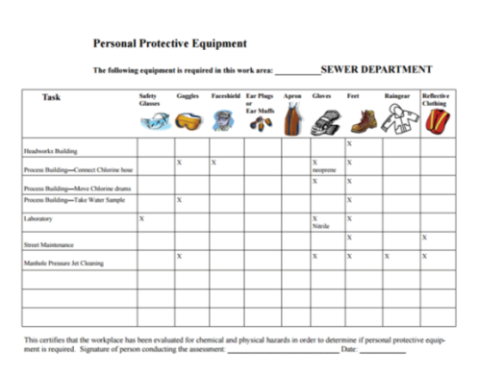
DLS Inspections for PPE
Written Warnings issued for:
Not providing PPE
No “Hazard Assessment for Selecting PPE”

Slide 36
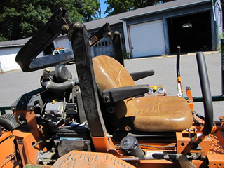
Myth: Safety Costs Too Much
Some people might say:
“But OSHA regulations are too expensive!”
What DLS really found:
Poor equipment maintenance;
Not using the equipment you already have;
Not using Owner’s Manuals.
Rollover Disabled
Seatbelt removed

Slide 37
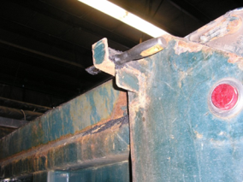
Myth: Safety Costs Too Much
In 2015, a DPW worker sustained a serious laceration when moving a gate on a dump truck.
DLS found:
Damaged latches
Gate on truck held together with a
putty knife instead of a
manufacturer-approved pin.
Written Warning included:
Lack of manufacturer-approved parts
Lack of pre-trip inspection
OSHA: 29 CFR 1910.601(b)(14)
Massachusetts Law M.G.L. c149 s6

Slide 38
Safety Management

Slide 39
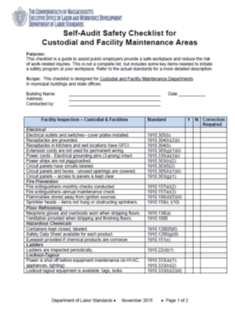
Surviving a DLS Safety Inspection
Preventive Maintenance
Use the tool’s Owner’s Manual
Incorporate safety into your operations.
Audit yourself.
www.mass.gov/dols/wshp
for sample programs and
self-audit checklists.

Slide 40
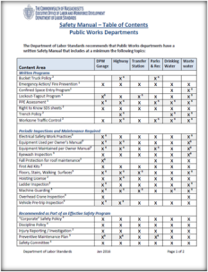
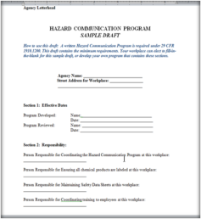
Handouts Available www.mass.gov/dols
Table of Contents
for a Safety Manual
Schools
Public Works
Sample Programs
Fill-in-the-Blank
Designed for baseline compliance.
You can add more sections

Slide 41
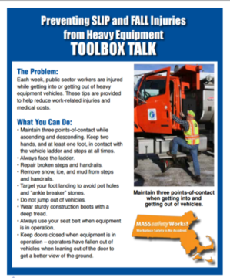
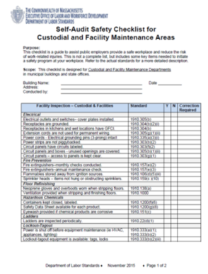
Handouts Available www.mass.gov/dols
Toolbox training talks
Self-Audit Checklists

Slide 42

Wrap-Up
What are the Safety Regulations for public sector workplaces?
What happens during a DLS safety inspection?
Examples of violations found at recent DLS inspections.
Department of Labor Standards
508-616-0461
www.mass.gov/dols/wshp

