Slide 1
AHERA: The Cost of Non-Compliance
MA Department of Labor Standards
Janet McKenna

Slide 2
Top 5 Most Co$tly Violations
#1: Failing to notify outside contractors
#2: Failing to have a project design
#3: Failing to sample suspect materials or identify ACM
#4: Failing to train personnel (custodial/maintenance/DP)
#5: Failing to maintain an updated management plan in each school

Slide 3
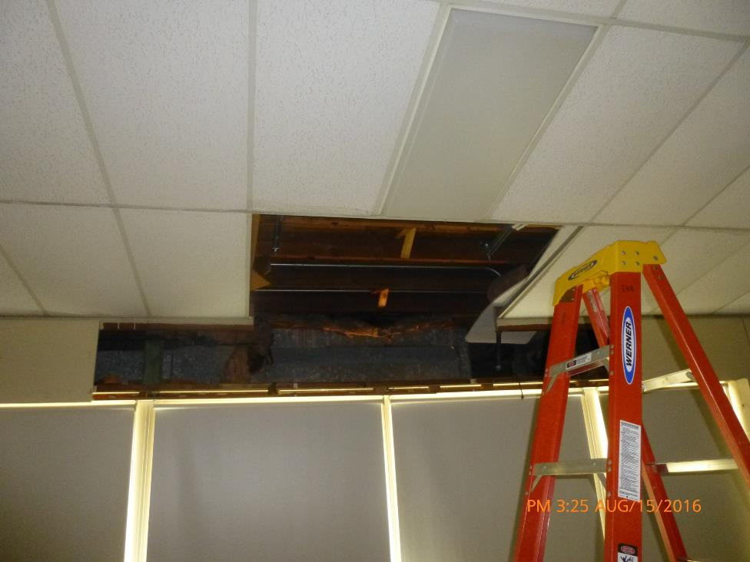

Slide 4
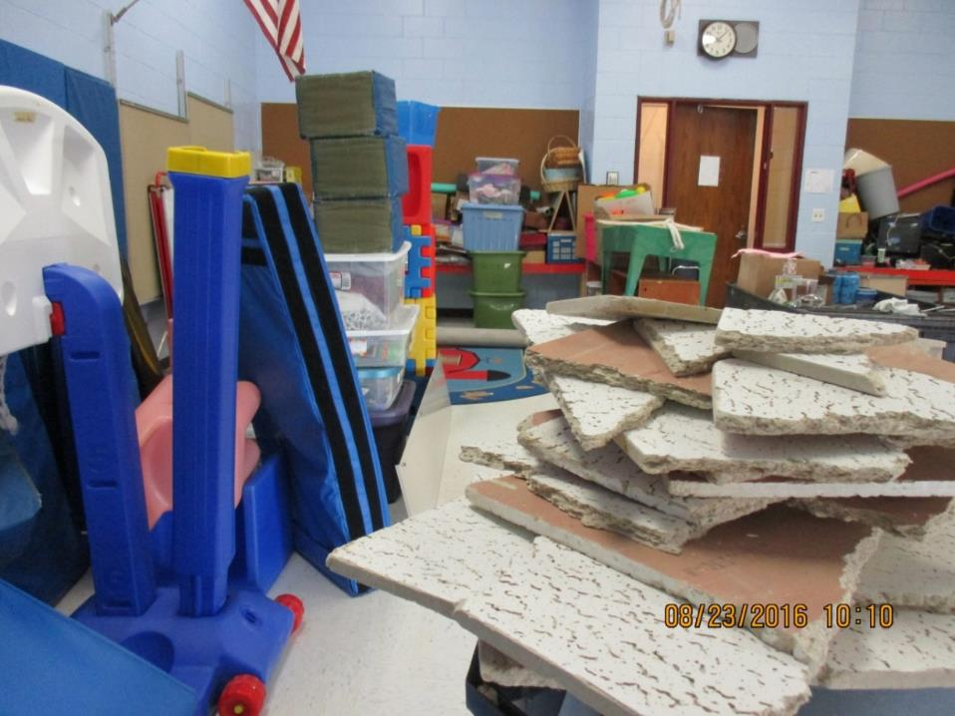

Slide 5
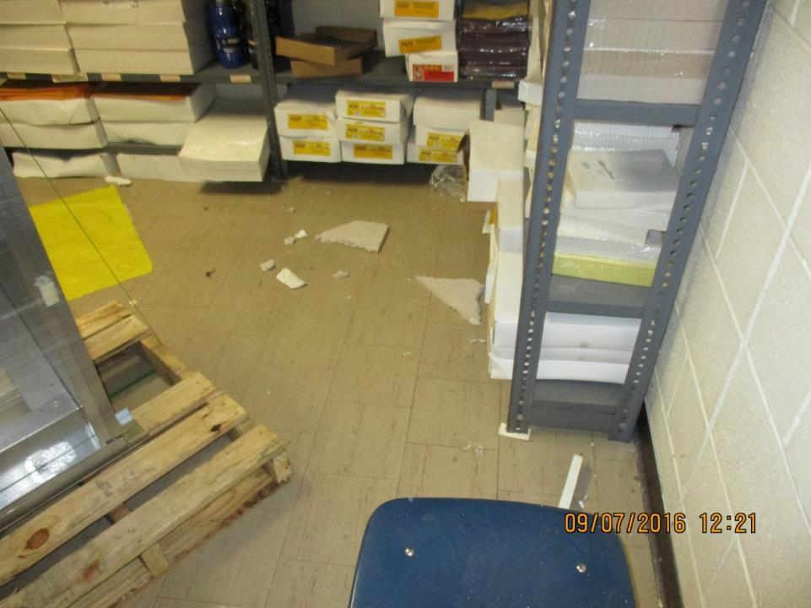

Slide 6
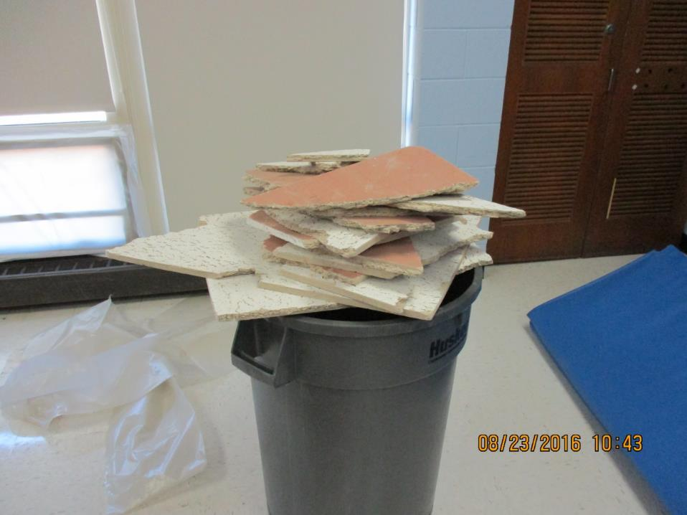

Slide 7
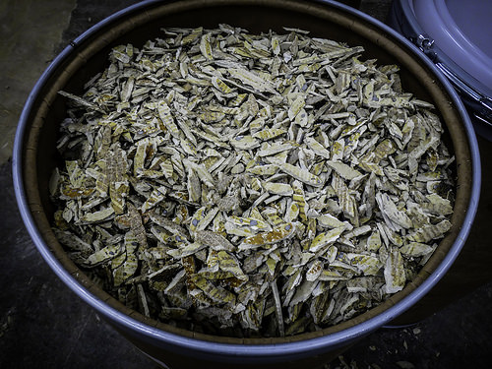
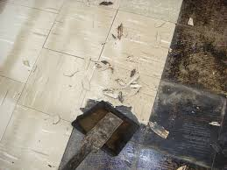
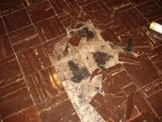

Slide 8
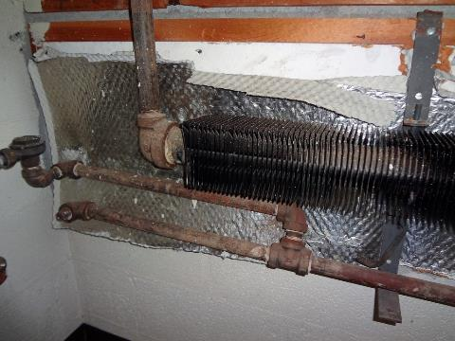
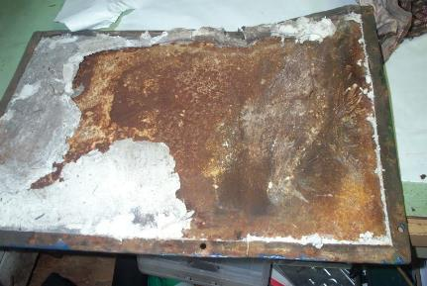

Slide 9
1. Case Studies-The Perfect Storm
What is the Common Denominator?
1. Teaticket Elementary
2. Cape Cod Voc Tech HS
3. Archbishop Williams HS
How did the problem start??
What’s the first step in resolution?
How can you prevent it in the future?
Who is ultimately responsible for AHERA compliance

Slide 10
2. Current Issues for LEA
Renovations: NESHAP vs. AHERA
Sampling: what to sample, how to sample
Writing a specification for a pre-reno survey
Hierarchy of parties: who hires who? How does this affect AHERA compliance?
  Architect
  General Contractor
  Asbestos Contractor
  Project Manager
  Project Monitor
  Local Education Agency

Slide 11
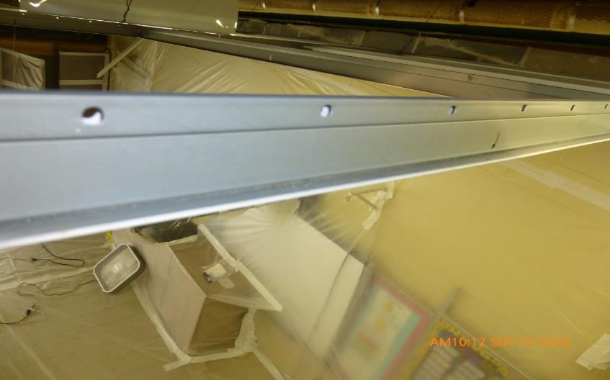
Who’s Responsible? Who Pays?

Slide 12
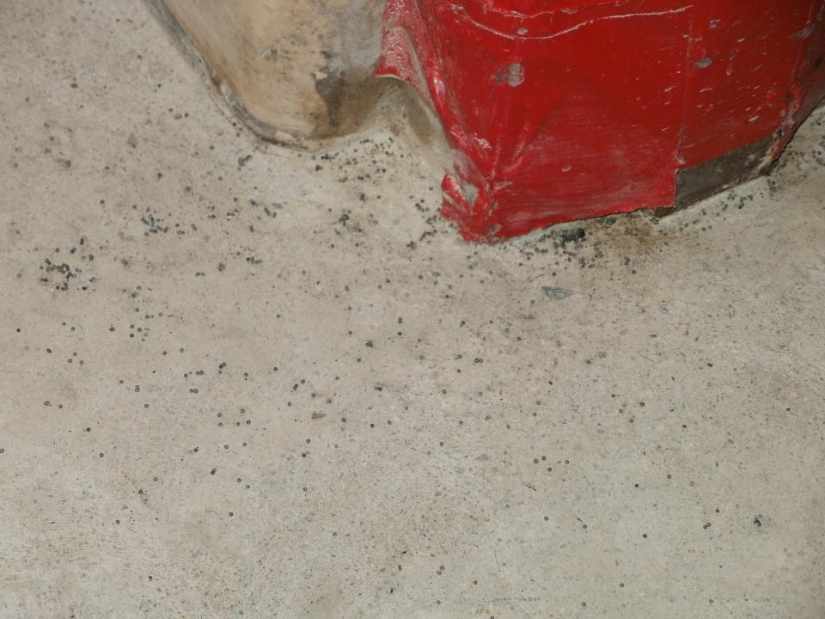

Slide 13
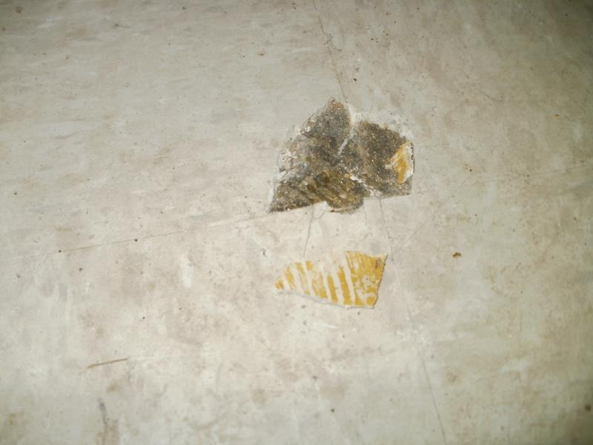
Damaged? Friable?

Slide 14
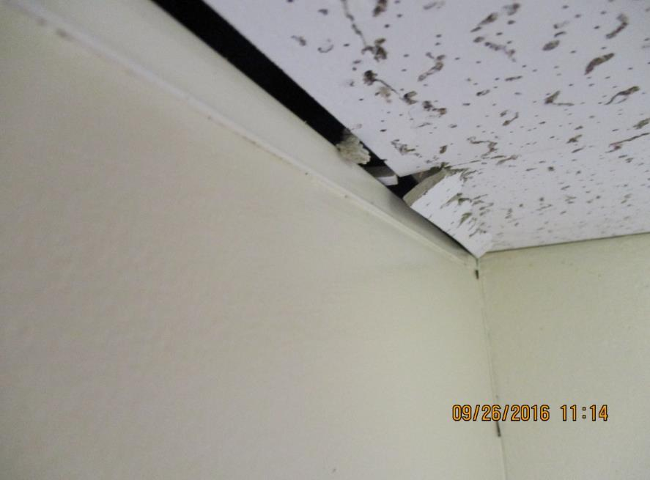

Slide 15
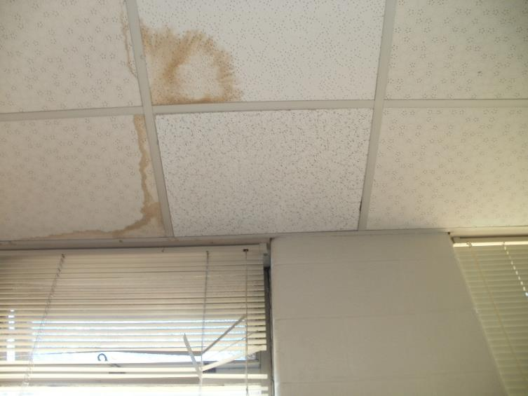
In House or Asbestos Contractor

Slide 16
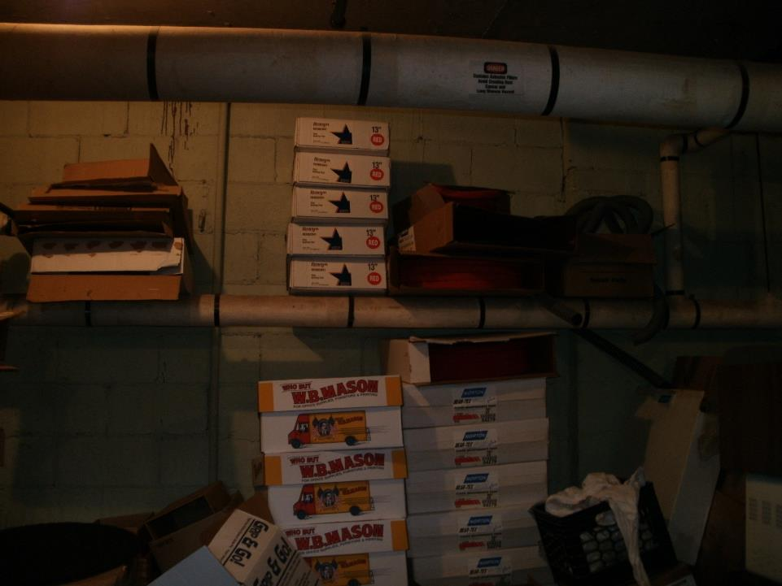

Slide 17
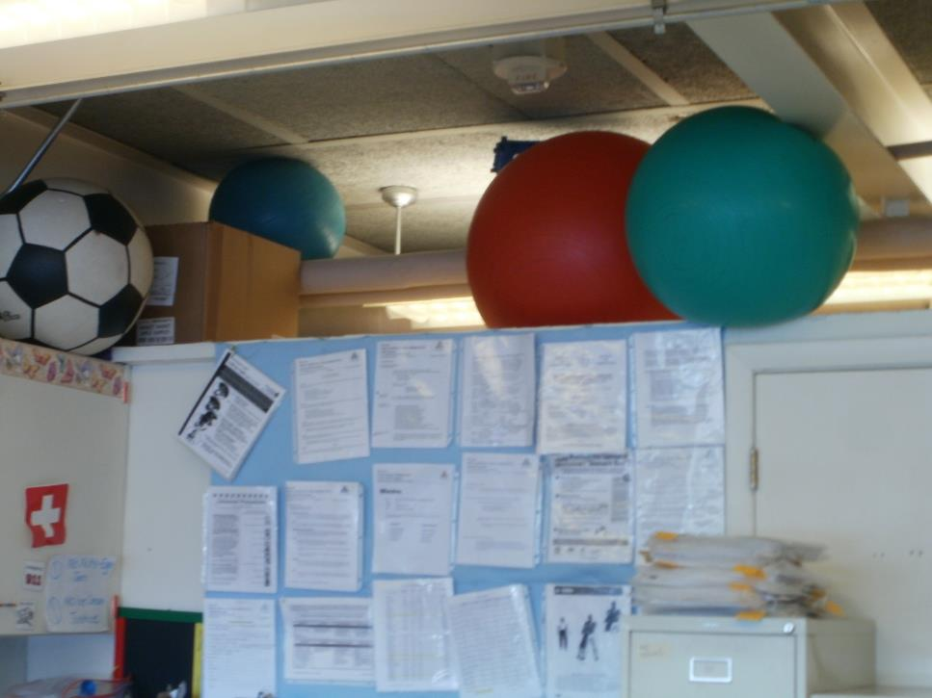

Slide 18
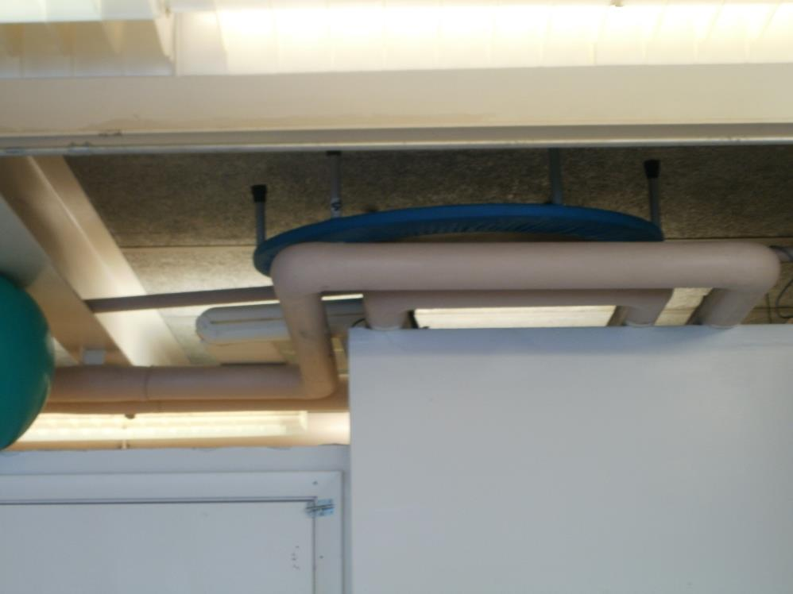
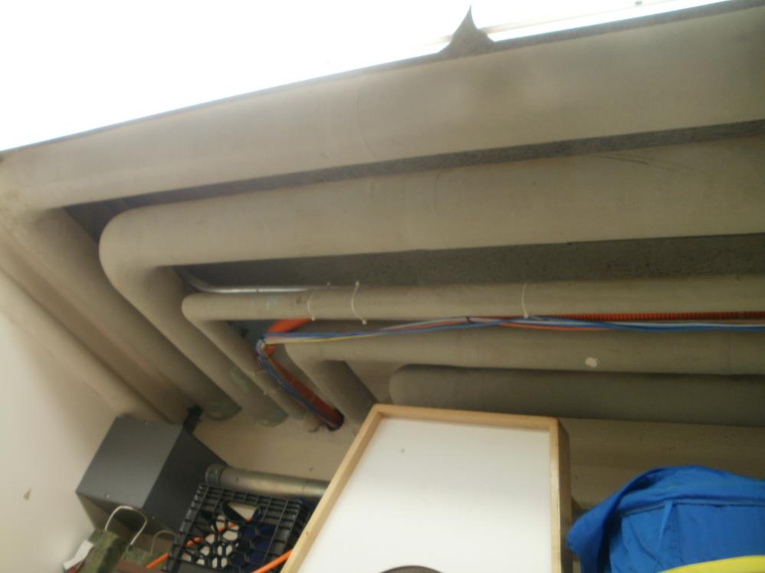

Slide 19
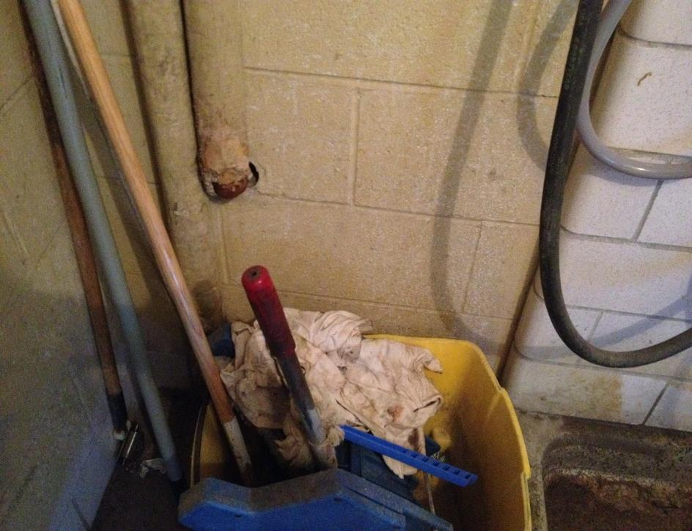

Slide 20
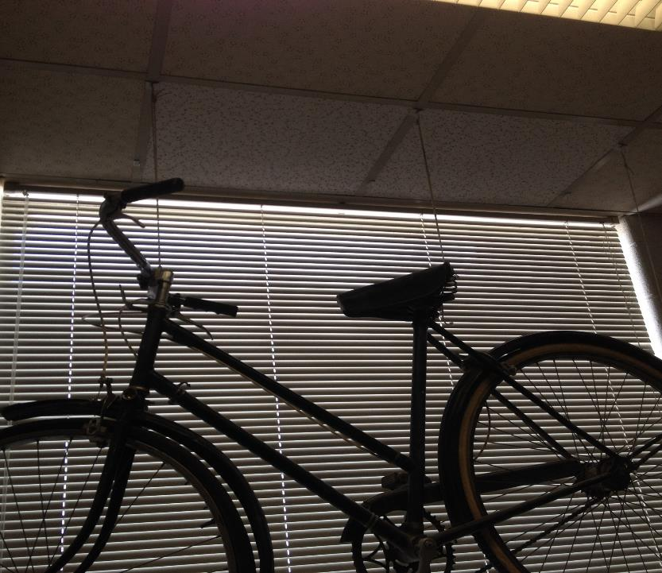

Slide 21
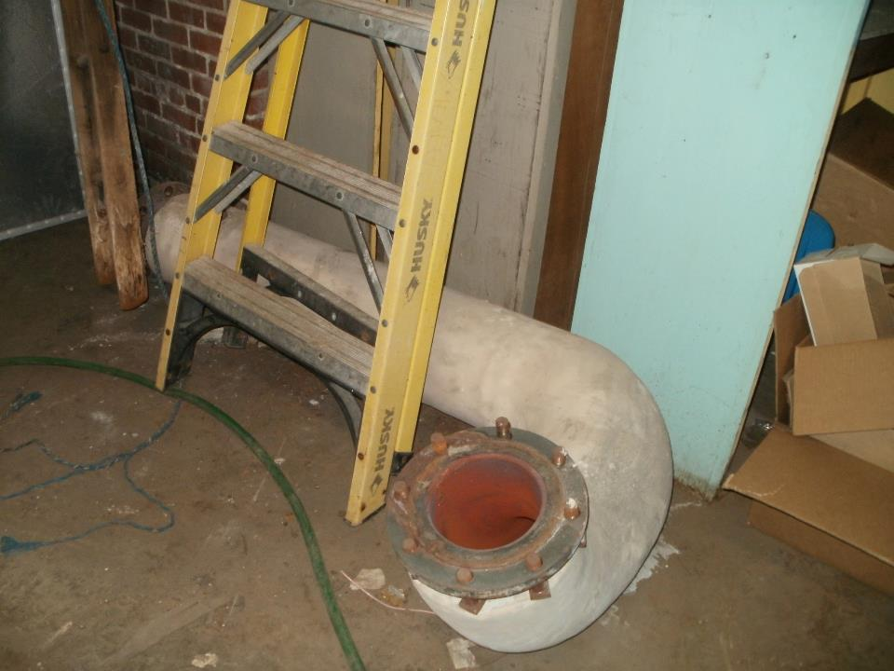

Slide 22
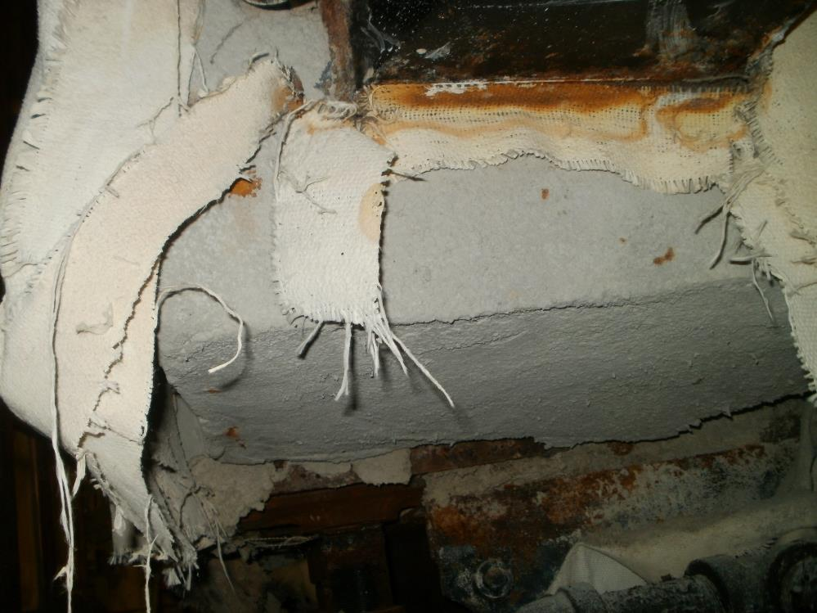

Slide 23
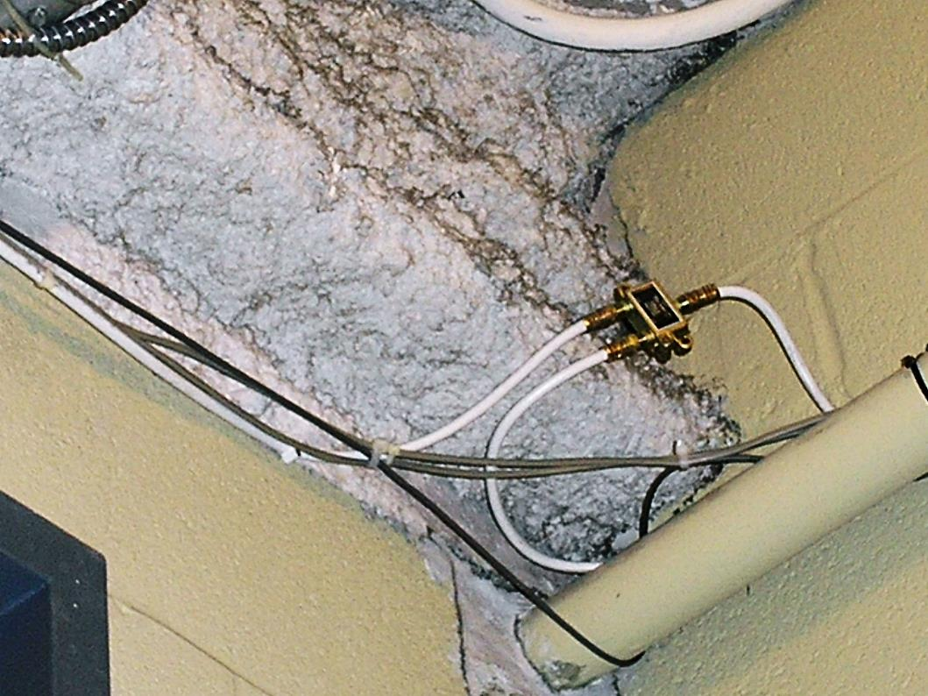

Slide 24
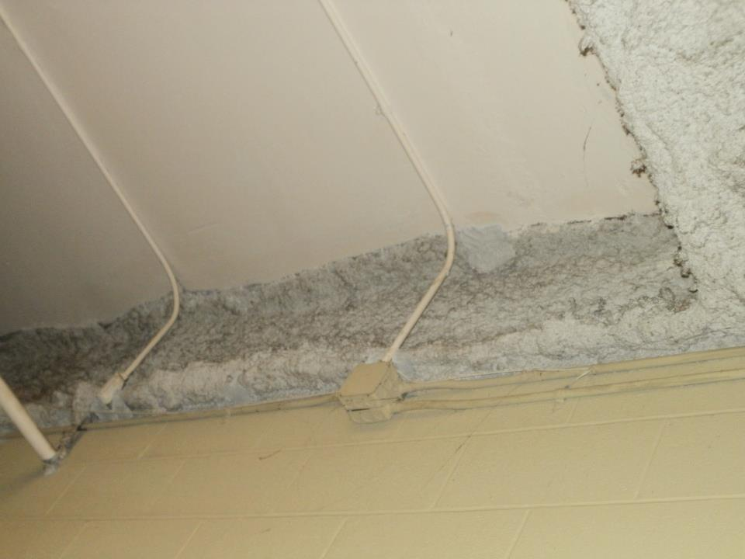

Slide 25
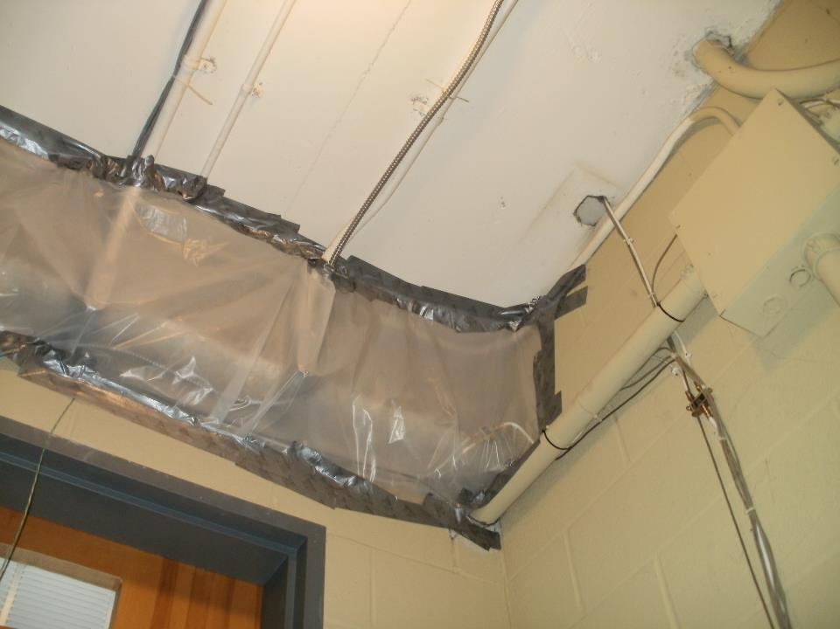

Slide 26
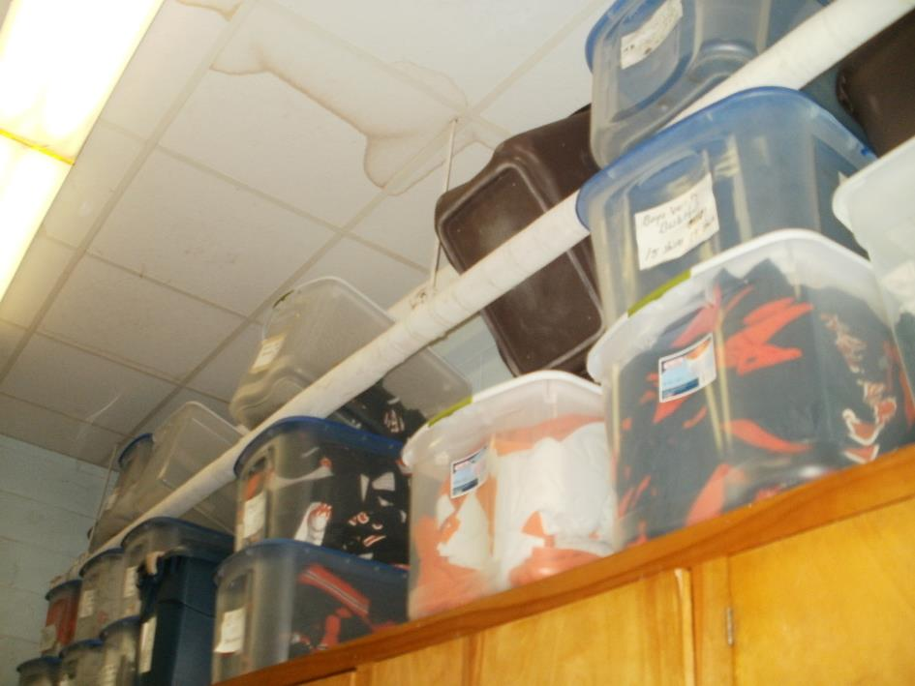

Slide 27
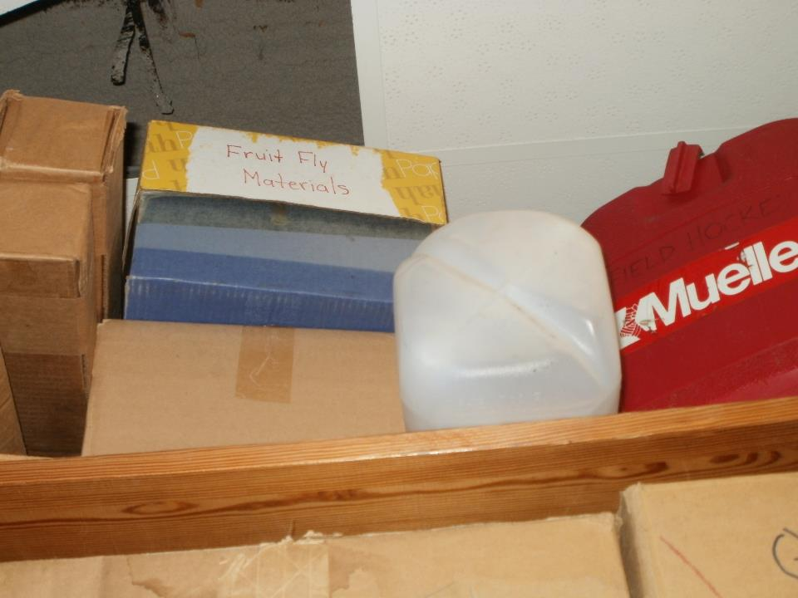

Slide 28
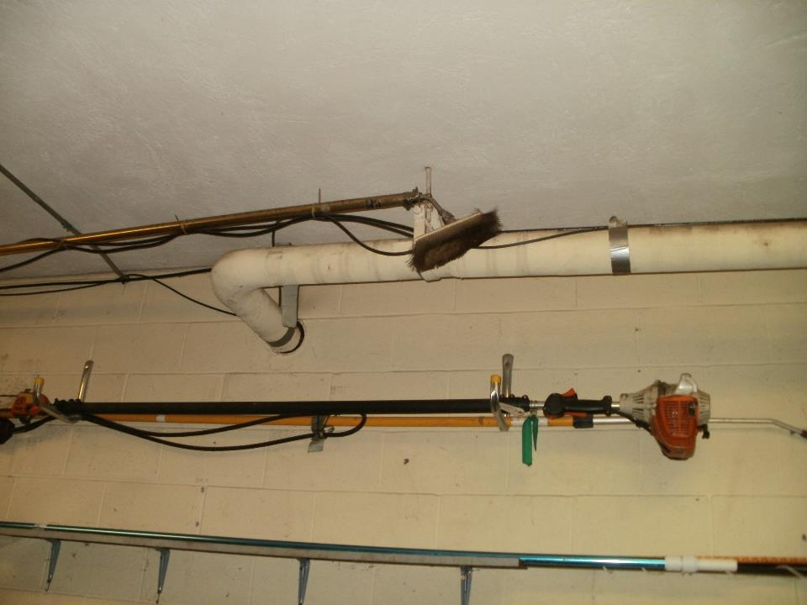

Slide 29
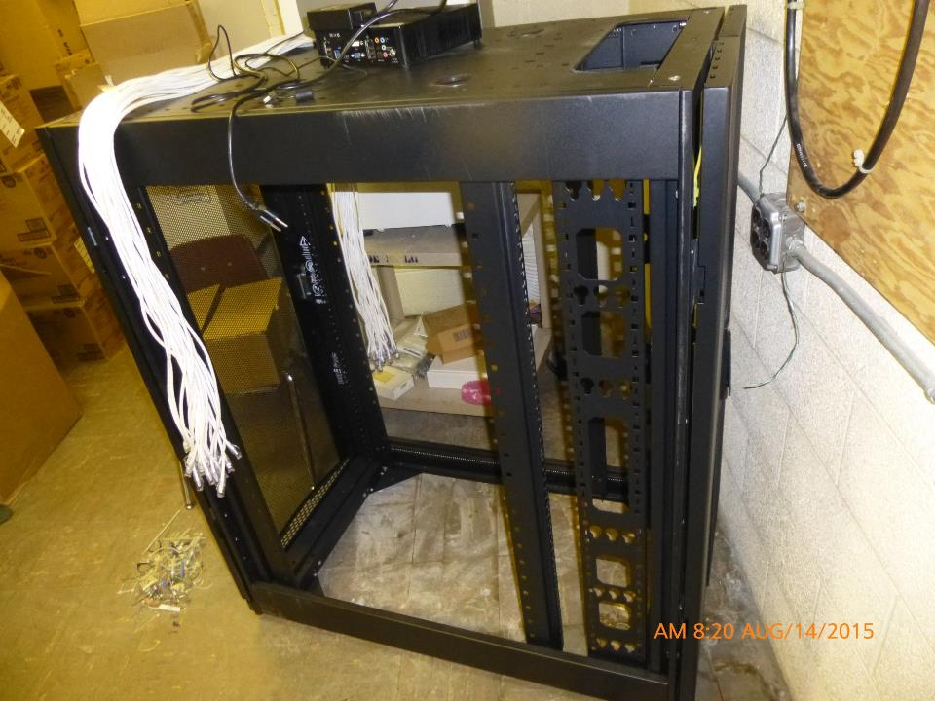

Slide 30
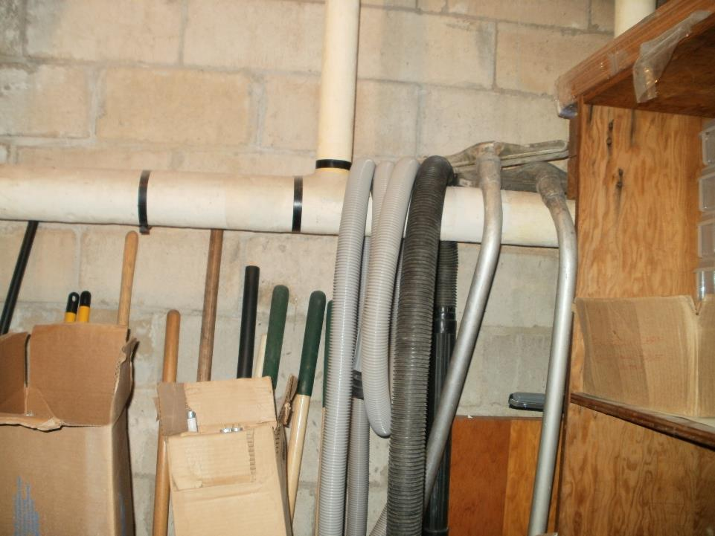

Slide 31
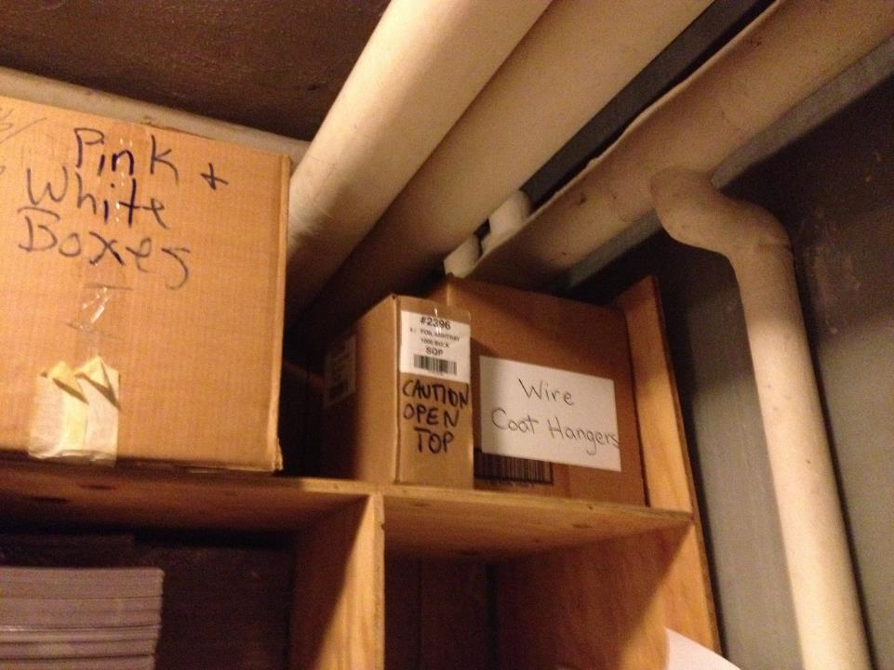

Slide 32
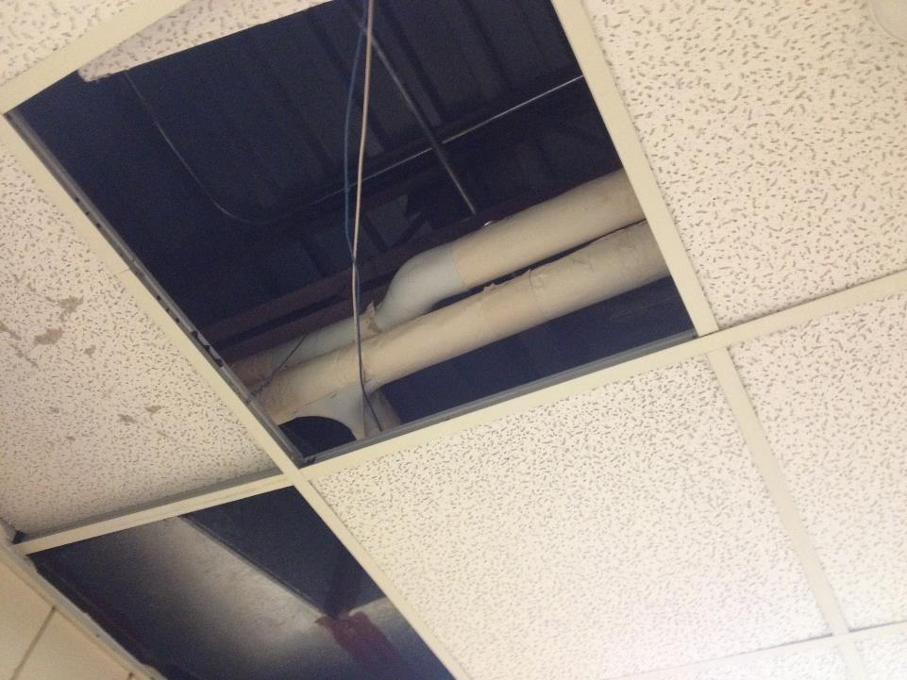

Slide 33
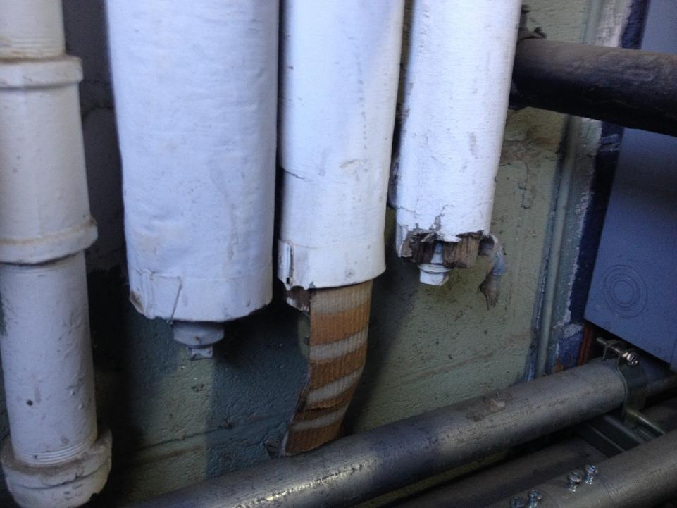

Slide 34
3. Asbestos Removal
Know the process!
Project Designs vs. Generic work plan
Clearance air testing—consultants and independent project monitors
What records must be kept in the management plan
Timeline for record collection and retention

Slide 35
4. Reinspections
How to get a complete and accurate reinspection
How to manage the growing volume of AHERA documents
New construction and renovations exemption

Slide 36
5. Manage Asbestos in Place
Housekeeping practices
Small scale repairs—who, when, where, waste
Outside vendors-notifications
Other contributing factors: teachers, IT, unauthorized disturbances

Slide 37
Basic Steps for AHERA compliance
Track down your records
Evaluate or interview the consultant—get recommendations: Quality matters!
Plan ahead: proactive vs. reactive
Do the simple things:
  Annual notifications
  DP statement
  Architect statement
  Keep a copy of the management plan at the school

Slide 38
AHERA Self Test:
Do I know where the ACM is? Accessible?
Has it ever been tested or is it all assumed?
How much is there?
What condition is it in?
Can I find it to monitor it?
Do I have all the records I need from removal?
When was the last reinspection? Where is it?
When is the last time I looked at the Management Plan? Has it been updated?

Slide 39
How MFAA can help
Send architect statements for new buildings
Make sure your RFP/specifications are detailed: You don’t ask, you don’t get!
Ask for help—Ignorance is not bliss!
Train employees regularly
Be diligent with surveillance/monitoring of asbestos
Verify contractor/consultant licensure, training and compliance history

Slide 40

Don’t Ignore the Elephant in the Room

